Slide 1
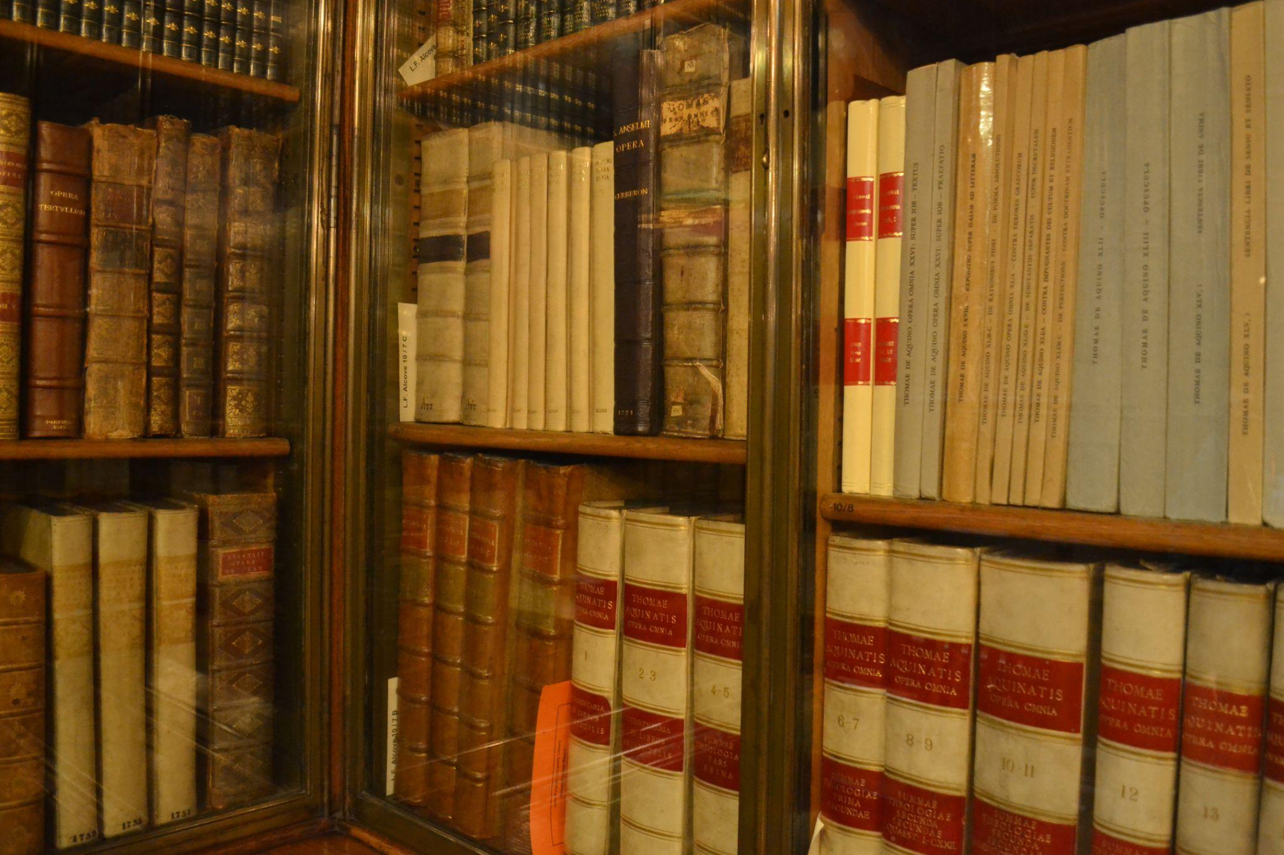
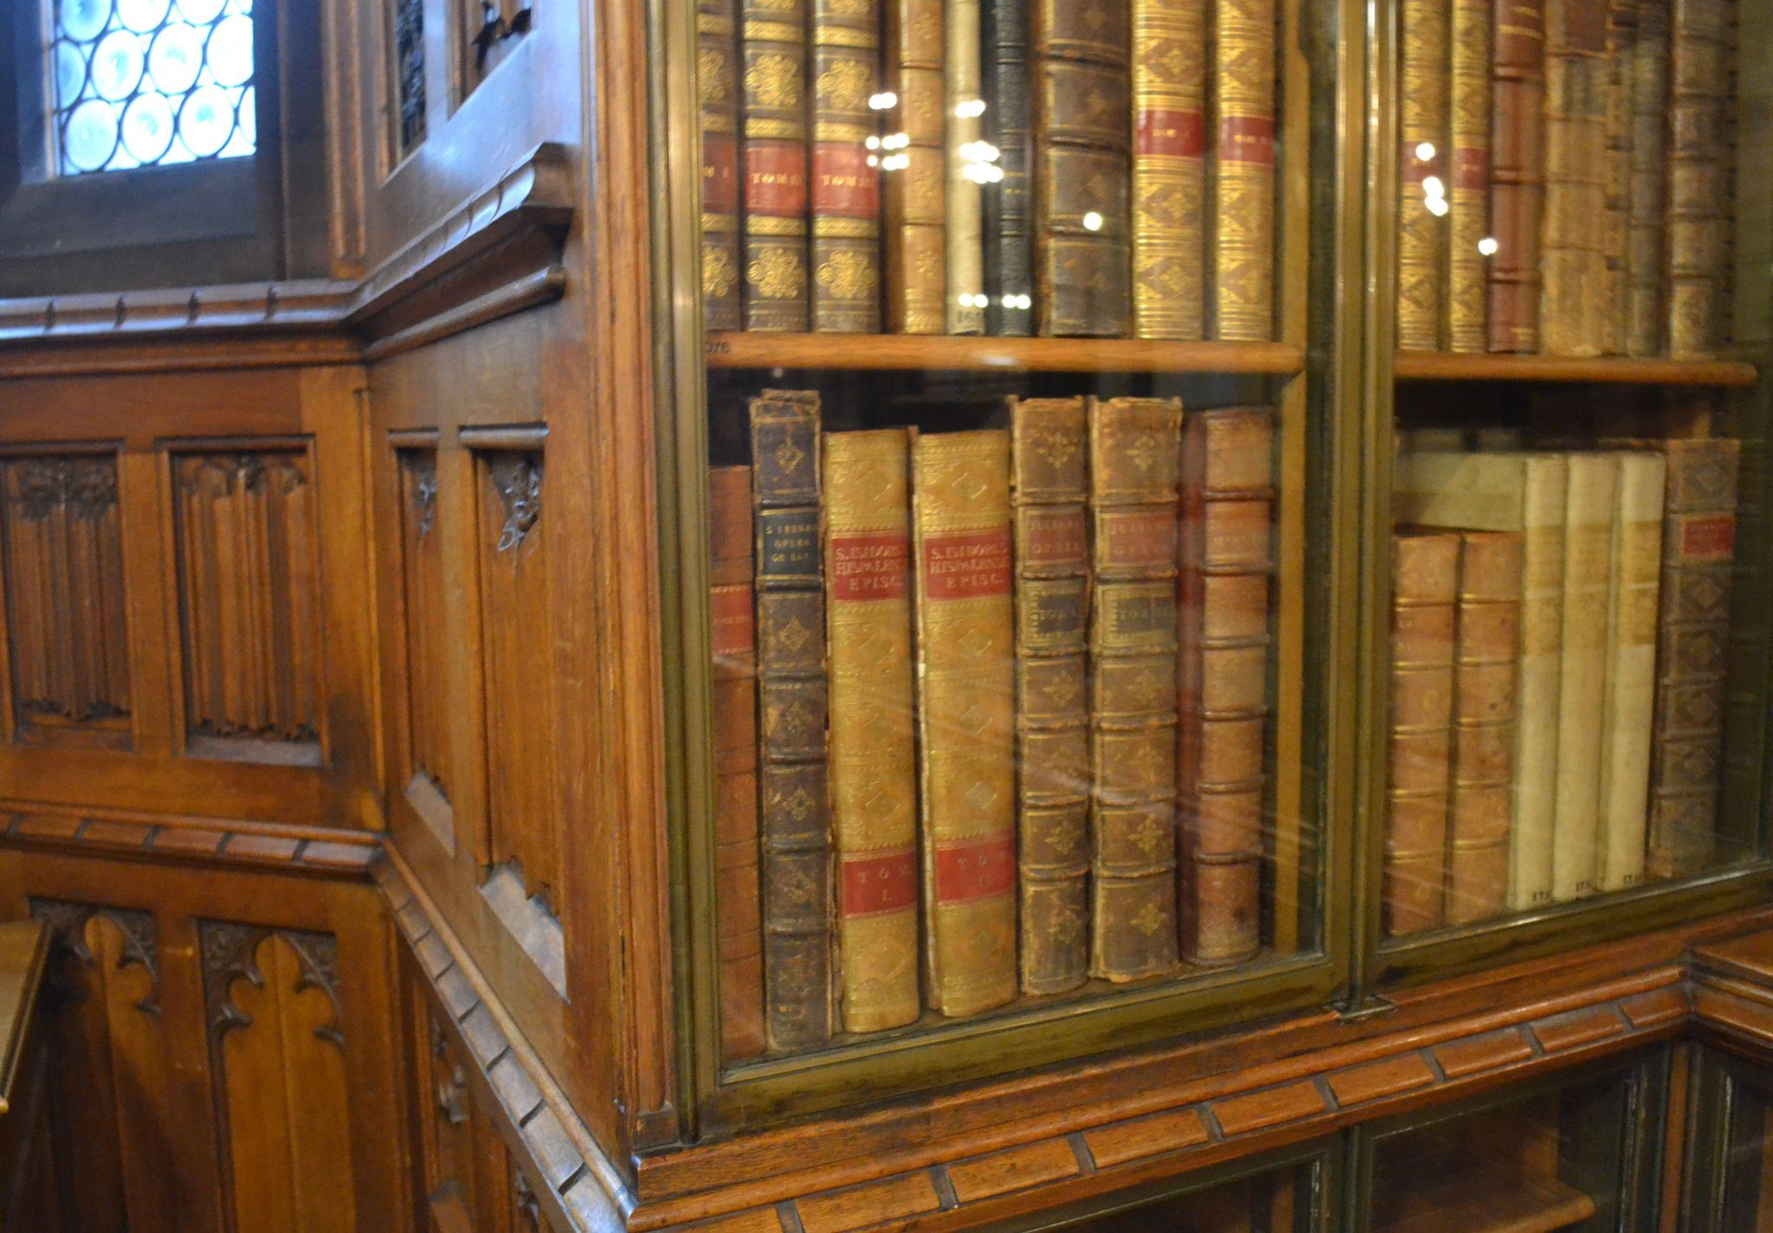
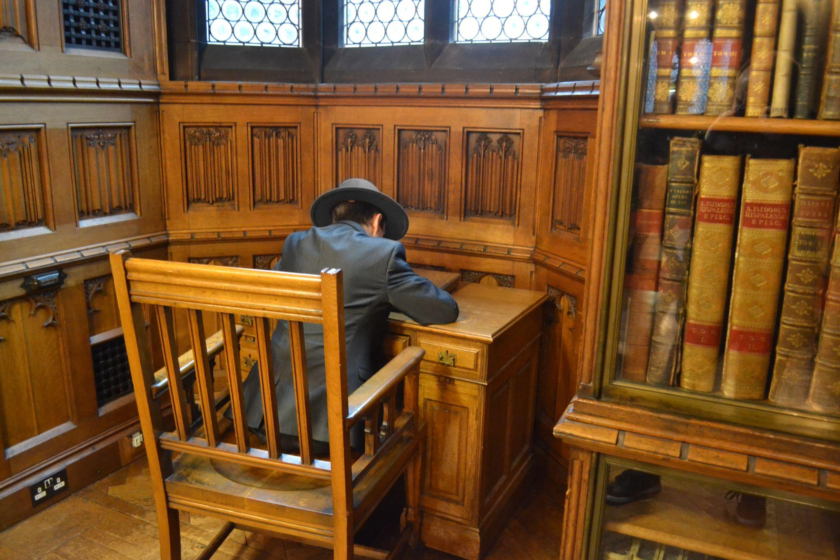
Name: WIlliam Smith
Candidate No:
Production Title: The Final Visitor
Sheet 1 of 22
Scene Heading | INT. STUDY – Day:
Shot No. | 1
Shot Type/ camera movement | Dolly (Mix of close ups, medium wide, low angle and high angle shots)
Lighting
Action/scene description/ dialogue from the screenplay | The room is dimly lit, filled with books and oddities. The sound of an old antique phone is heard being hung up
Diegetic Sound | Ambient sound of the location
Non Diegetic sound | non
Duration of shot | 8 seconds | Transition Type | continuous (fade in from black at begiinning

Slide 2
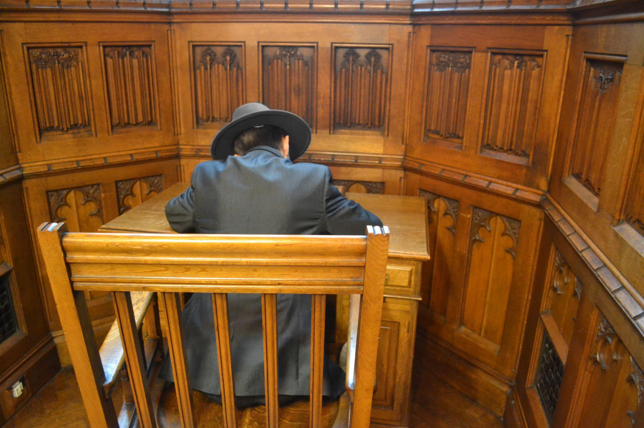
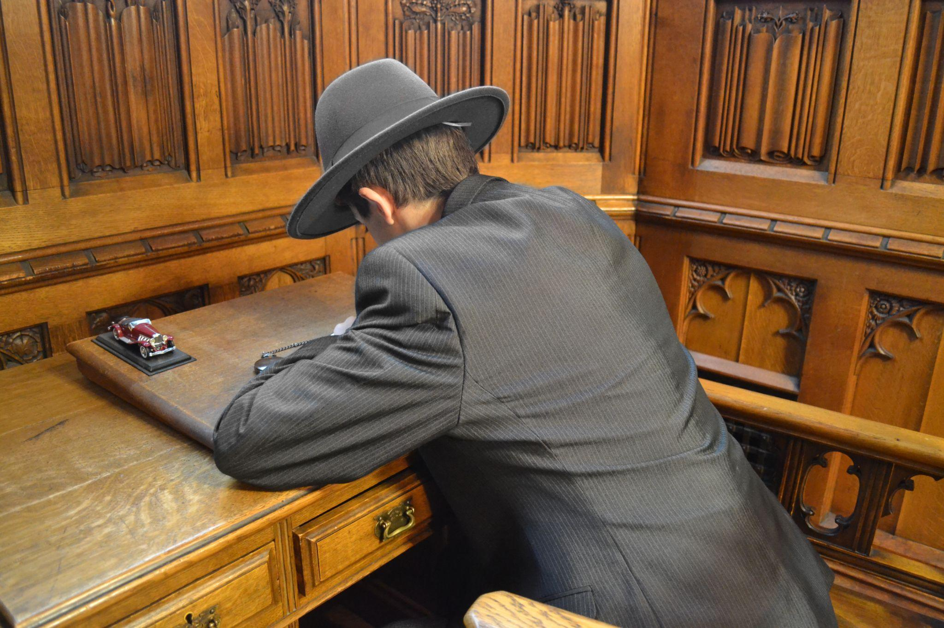
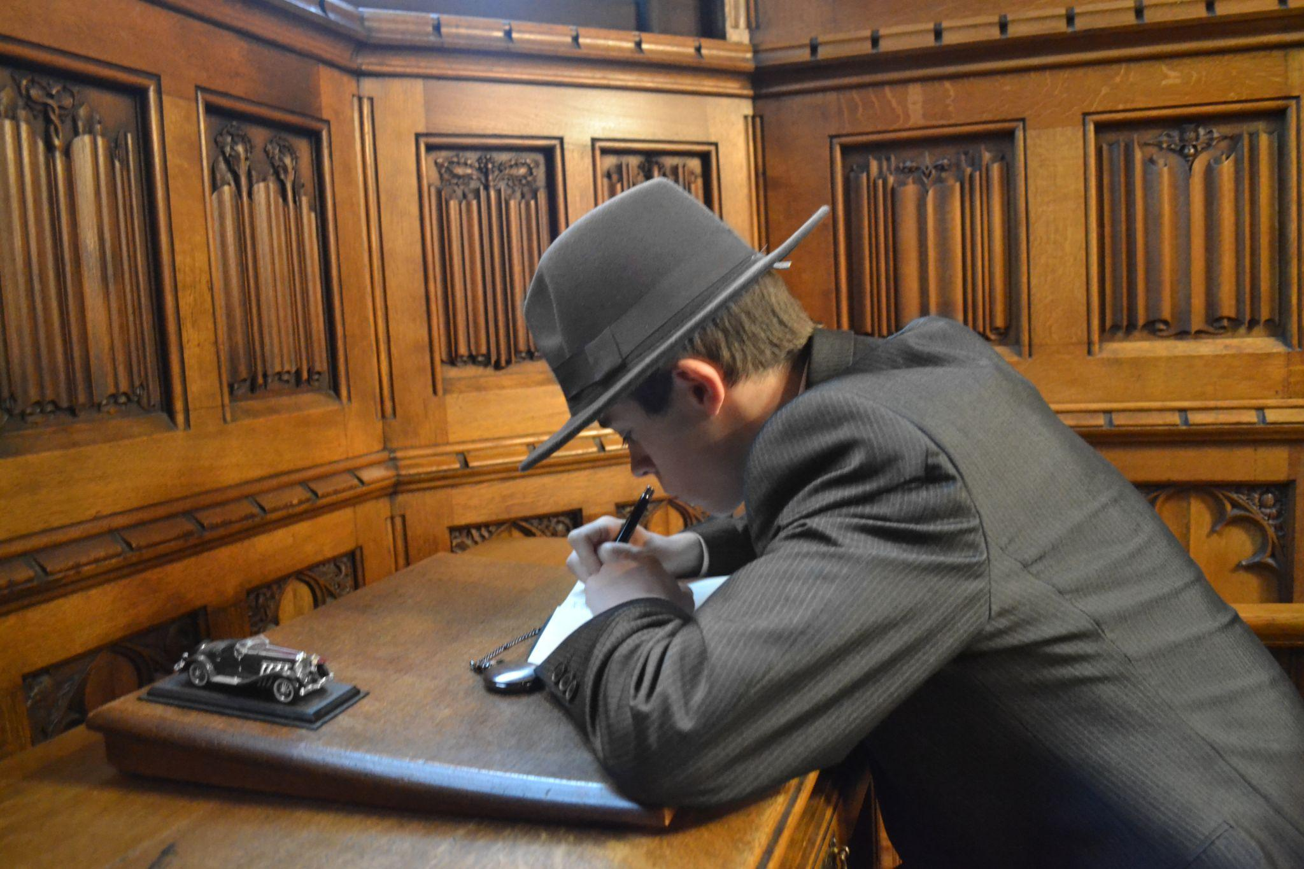
Name:
Candidate No:
Sheet 2 of 22
Scene Heading | INT. STUDY – Day:
Shot No. | 1
Shot Type/ camera movement | Dolly (Mix of close ups, medium wide, low angle and high angle shots)
Lighting
Action/scene description/ dialogue from the screenplay | The room is dimly lit, filled with books and oddities. The sound of an old antique phone is heard being hung up
Diegetic Sound | Ambient sound of the location
Non Diegetic sound | non
Duration of shot | 8 seconds | Transition Type | continuous (fade in from black at beginning

Slide 3
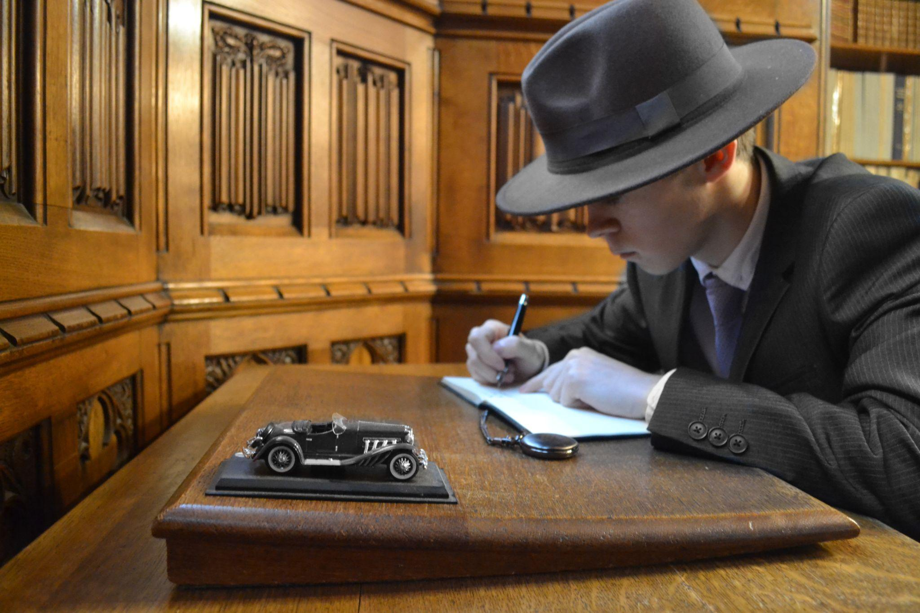
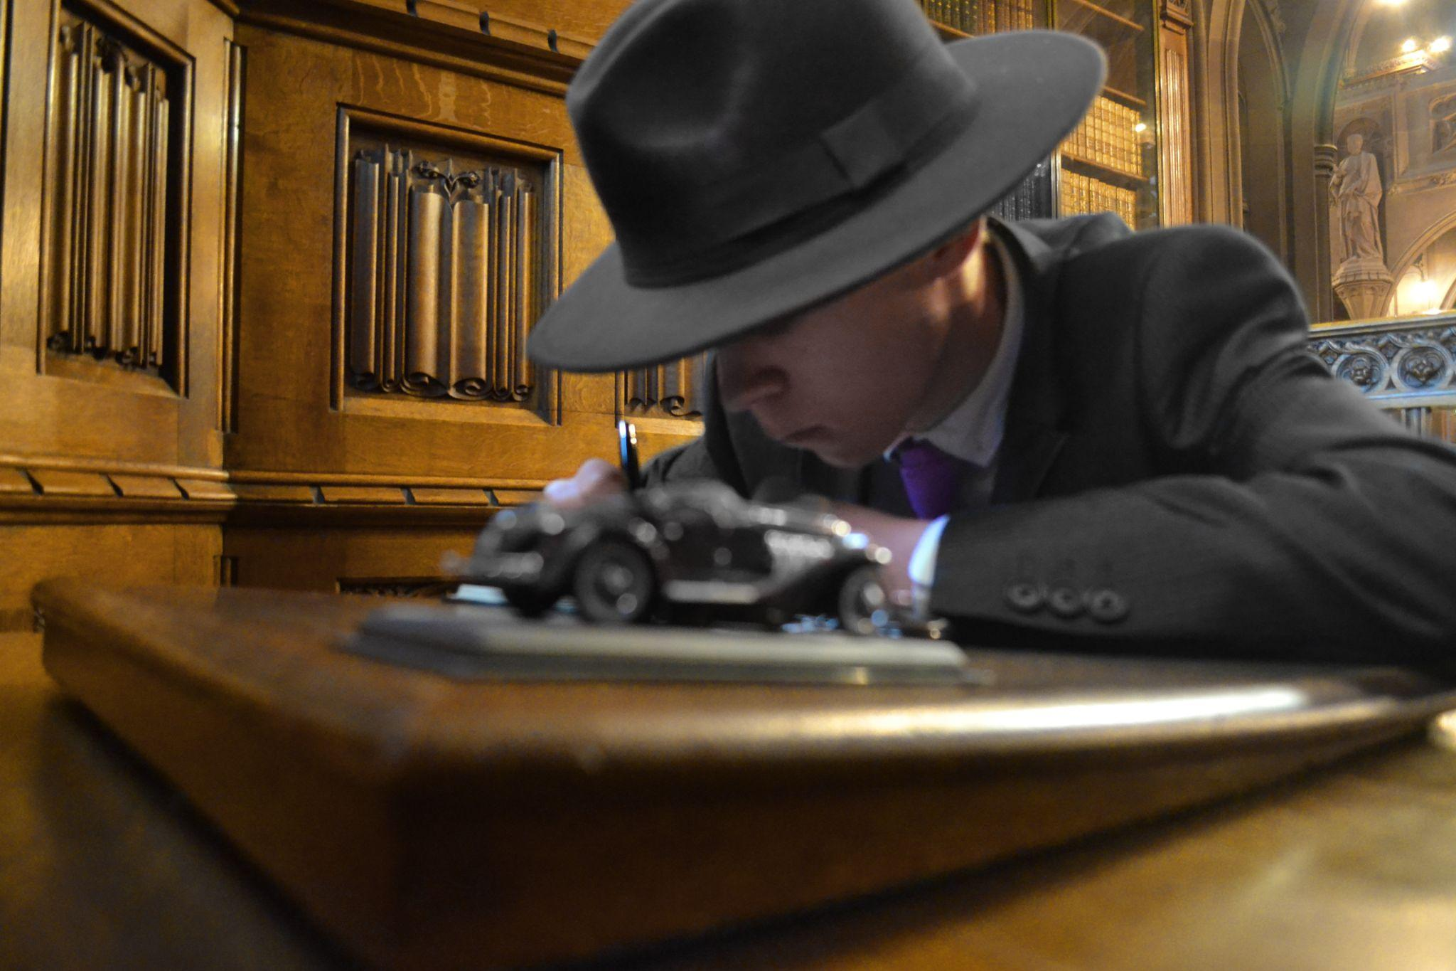
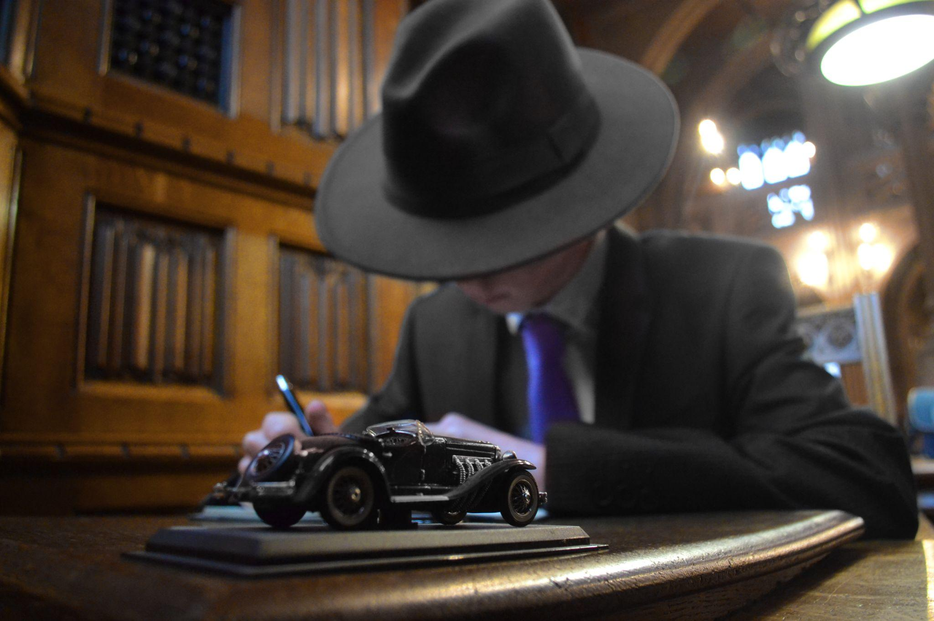
Name:
Candidate No:
Sheet 3 of 22
Scene Heading | INT. STUDY – Day:
Shot No. | 1
Shot Type/ camera movement | Dolly (Mix of close ups, medium wide, low angle and high angle shots)
Lighting
Action/scene description/ dialogue from the screenplay | The room is dimly lit, filled with books and oddities. The sound of an old antique phone is heard being hung up
Diegetic Sound | Ambient sound of the location
Non Diegetic sound | non
Duration of shot | 8 seconds | Transition Type | continuous (fade in from black at beginning

Slide 4
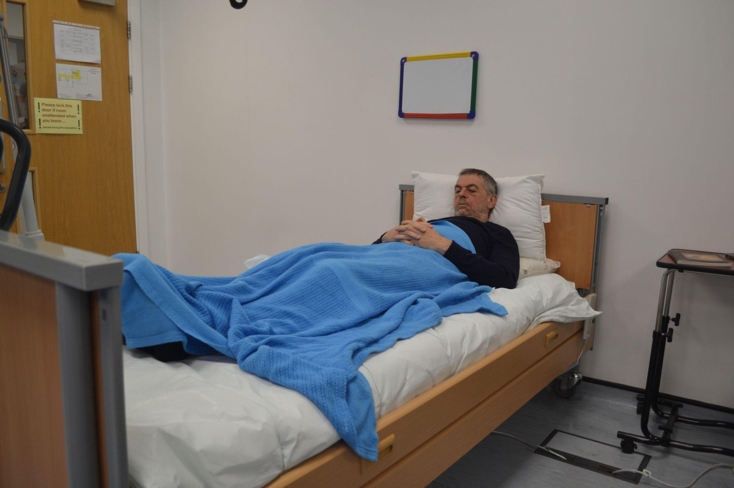
Name:
Candidate No:
Sheet 4 of 22
Scene Heading | INT. HOSPITAL ROOM – EARLY MORNING DAY:
Shot No. | 2
Shot Type/ camera movement | still (medium wide shot)
Lighting | Soft light
Action/scene description/ dialogue from the screenplay | A man sleeps in a hospital bed, bathed in soft morning light
Diegetic Sound | Ambient sound of the location (heart monitors beeping)
Non Diegetic sound | non
Duration of shot | 4 | Transition Type

Slide 5
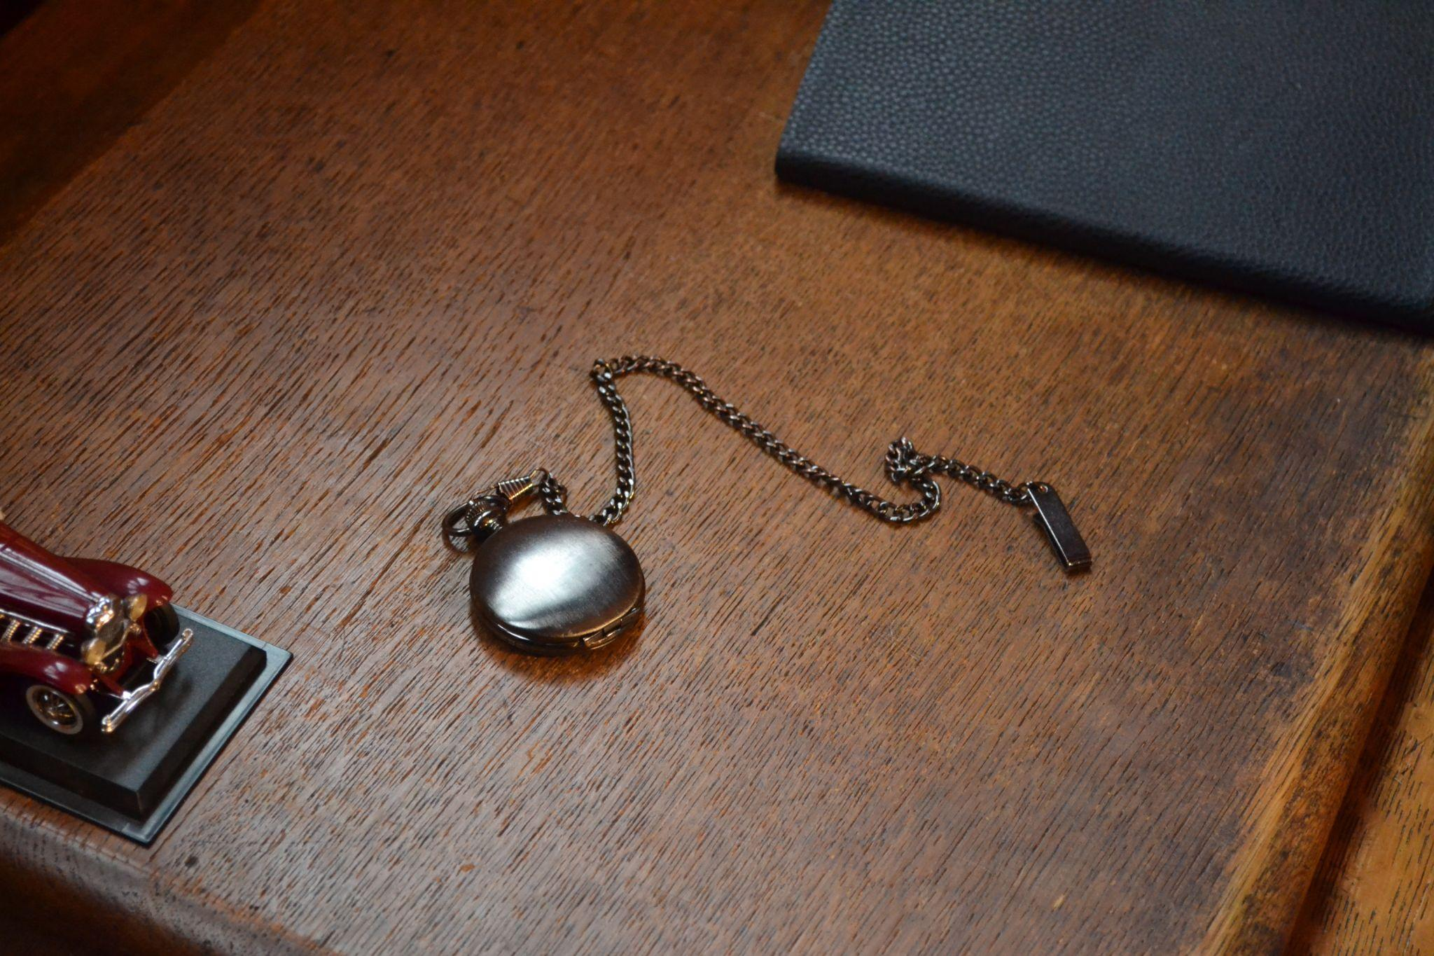
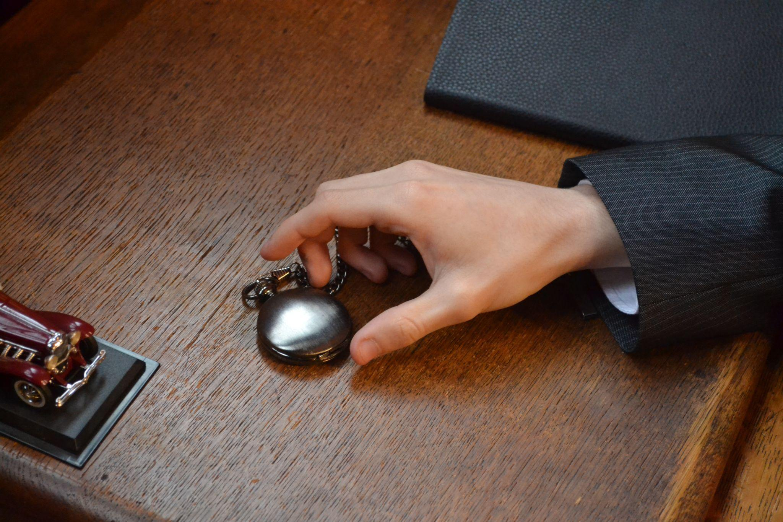
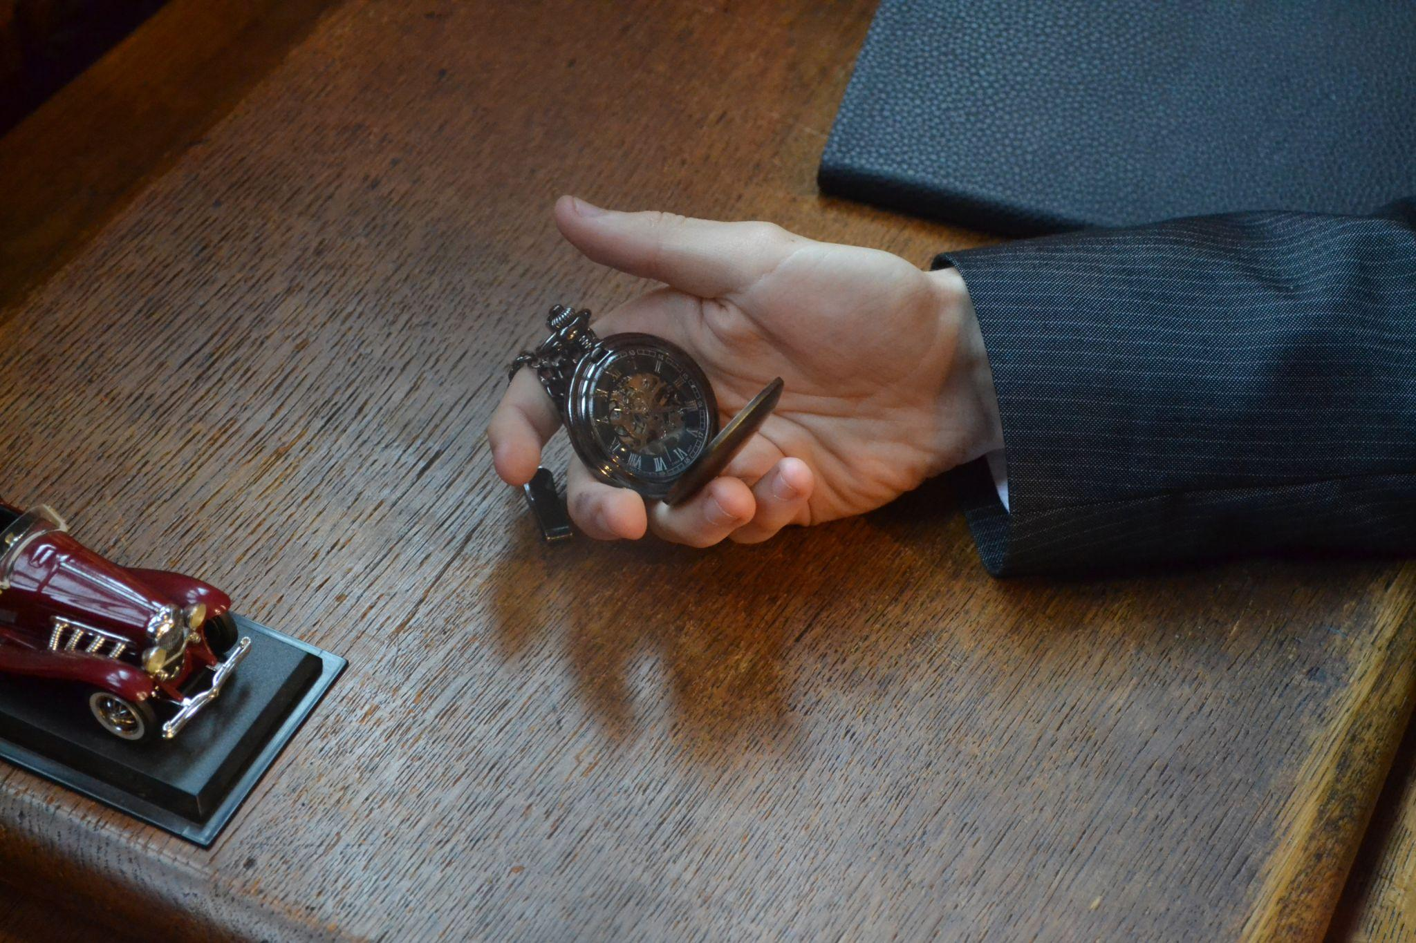
Name:
Candidate No:
Sheet 5 of 22
Scene Heading | INT. STUDY – Day:
Shot No. | 3
Shot Type/ camera movement | Medium Close up
Lighting | Dim light from above
Action/scene description/ dialogue from the screenplay | a hand reaches for a BRUSHED DARK GREY POCKET WATCH, lying next to a BLACK LEATHER BOOK. The hand belongs to the MYSTERIOUS MAN, dressed in a black suit, picking up items with care.
Diegetic Sound | Ambient sound of the location
Non Diegetic sound
Duration of shot | 5 | Transition Type | continuous shot

Slide 6
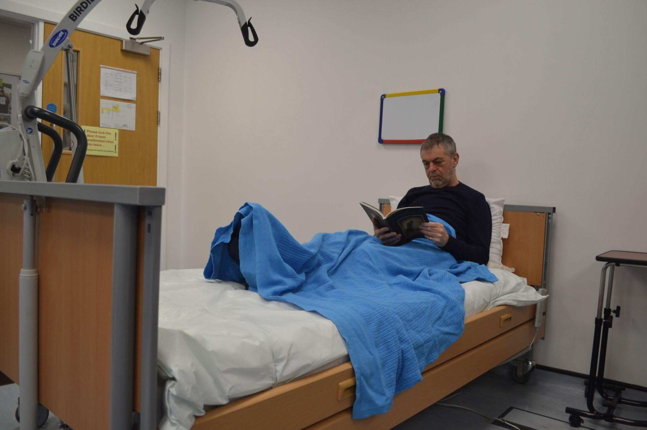
Name:
Candidate No:
Production Title:
Sheet 6 of 22
Scene Heading
Shot No. | 4
Shot Type/ camera movement
Lighting
Action/scene description/ dialogue from the screenplay
Diegetic Sound | Ambient sound of the location
Non Diegetic sound
Duration of shot |  | Transition Type

Slide 7
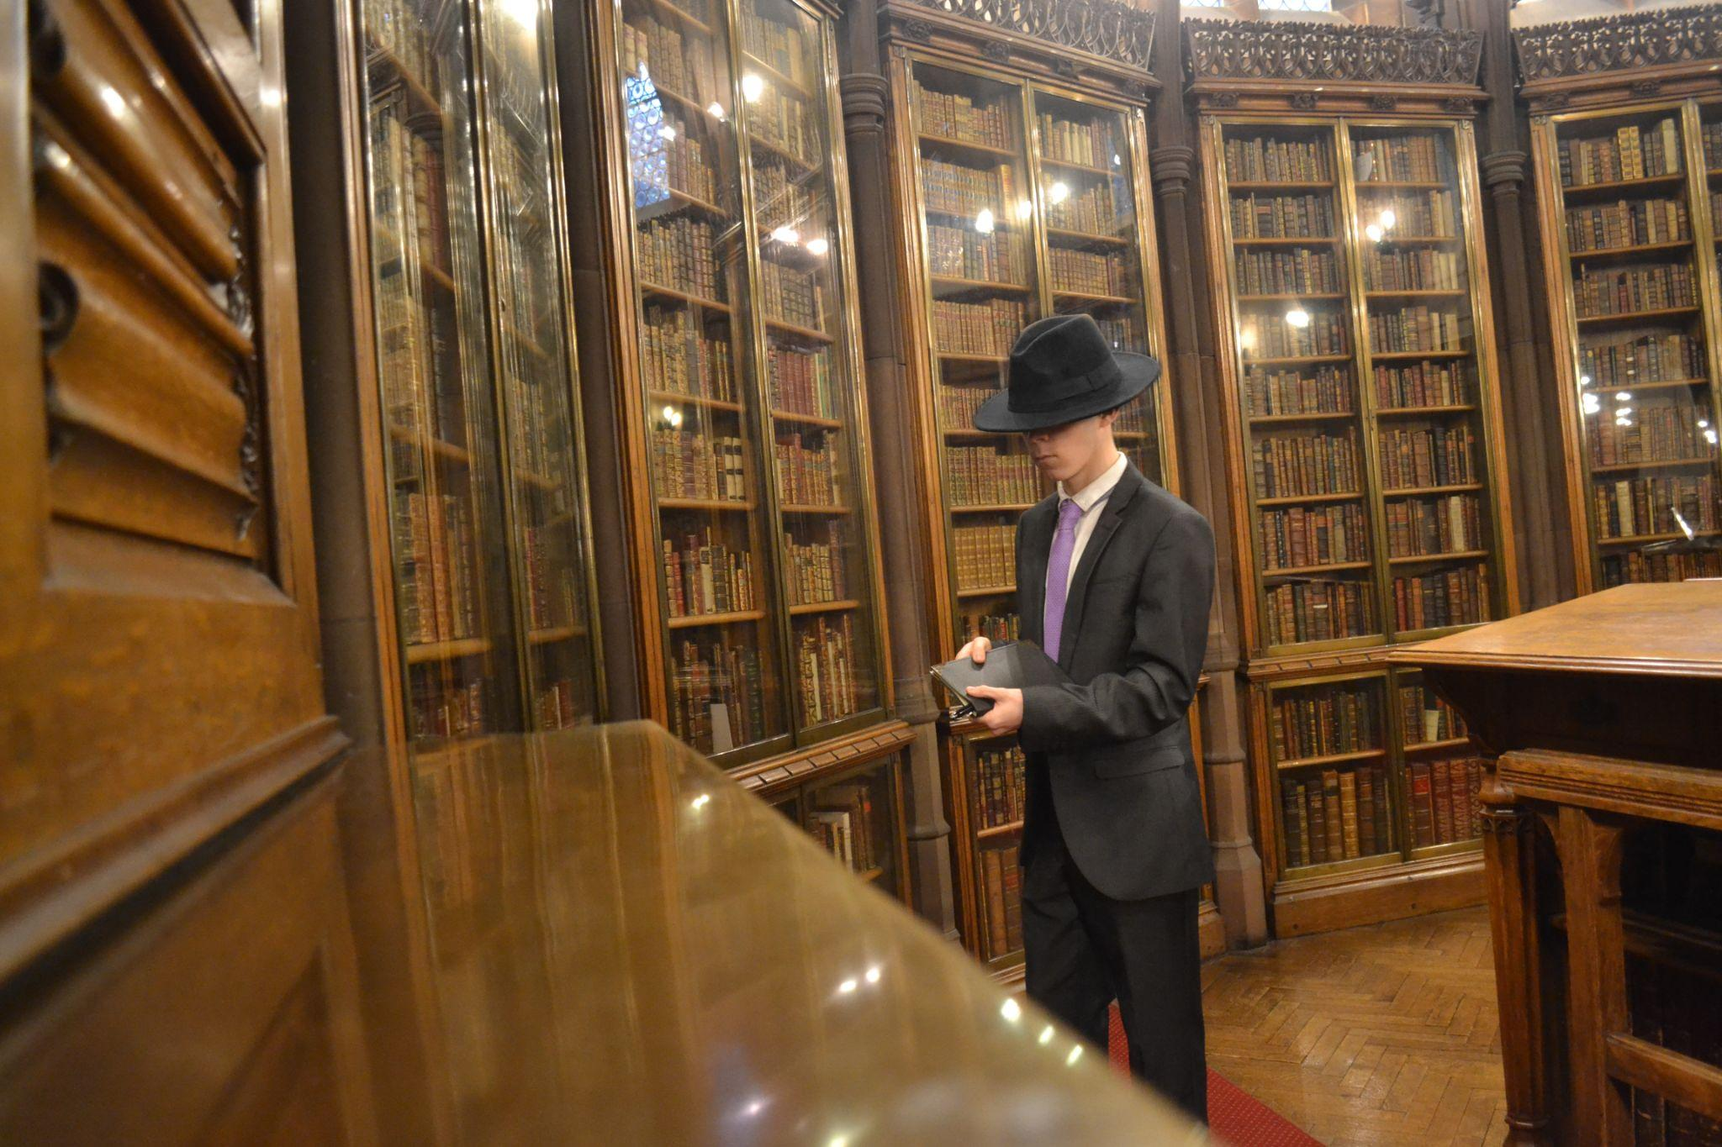
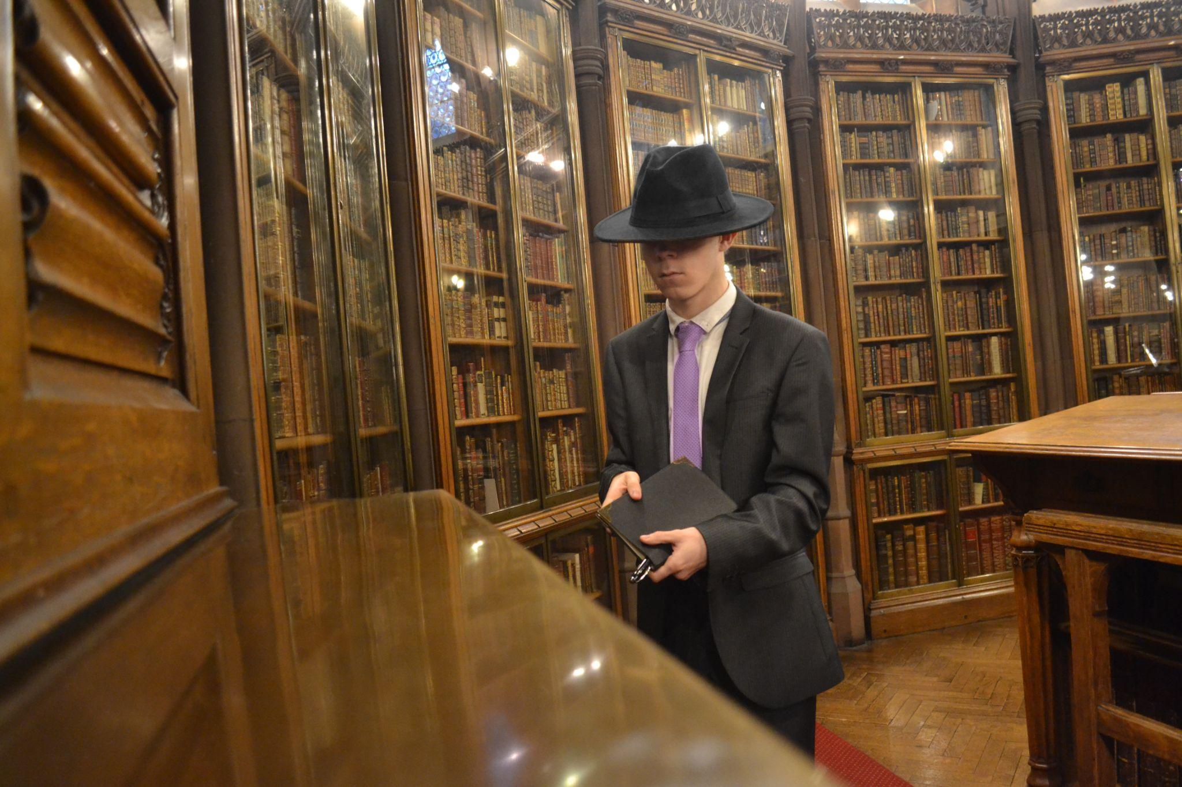
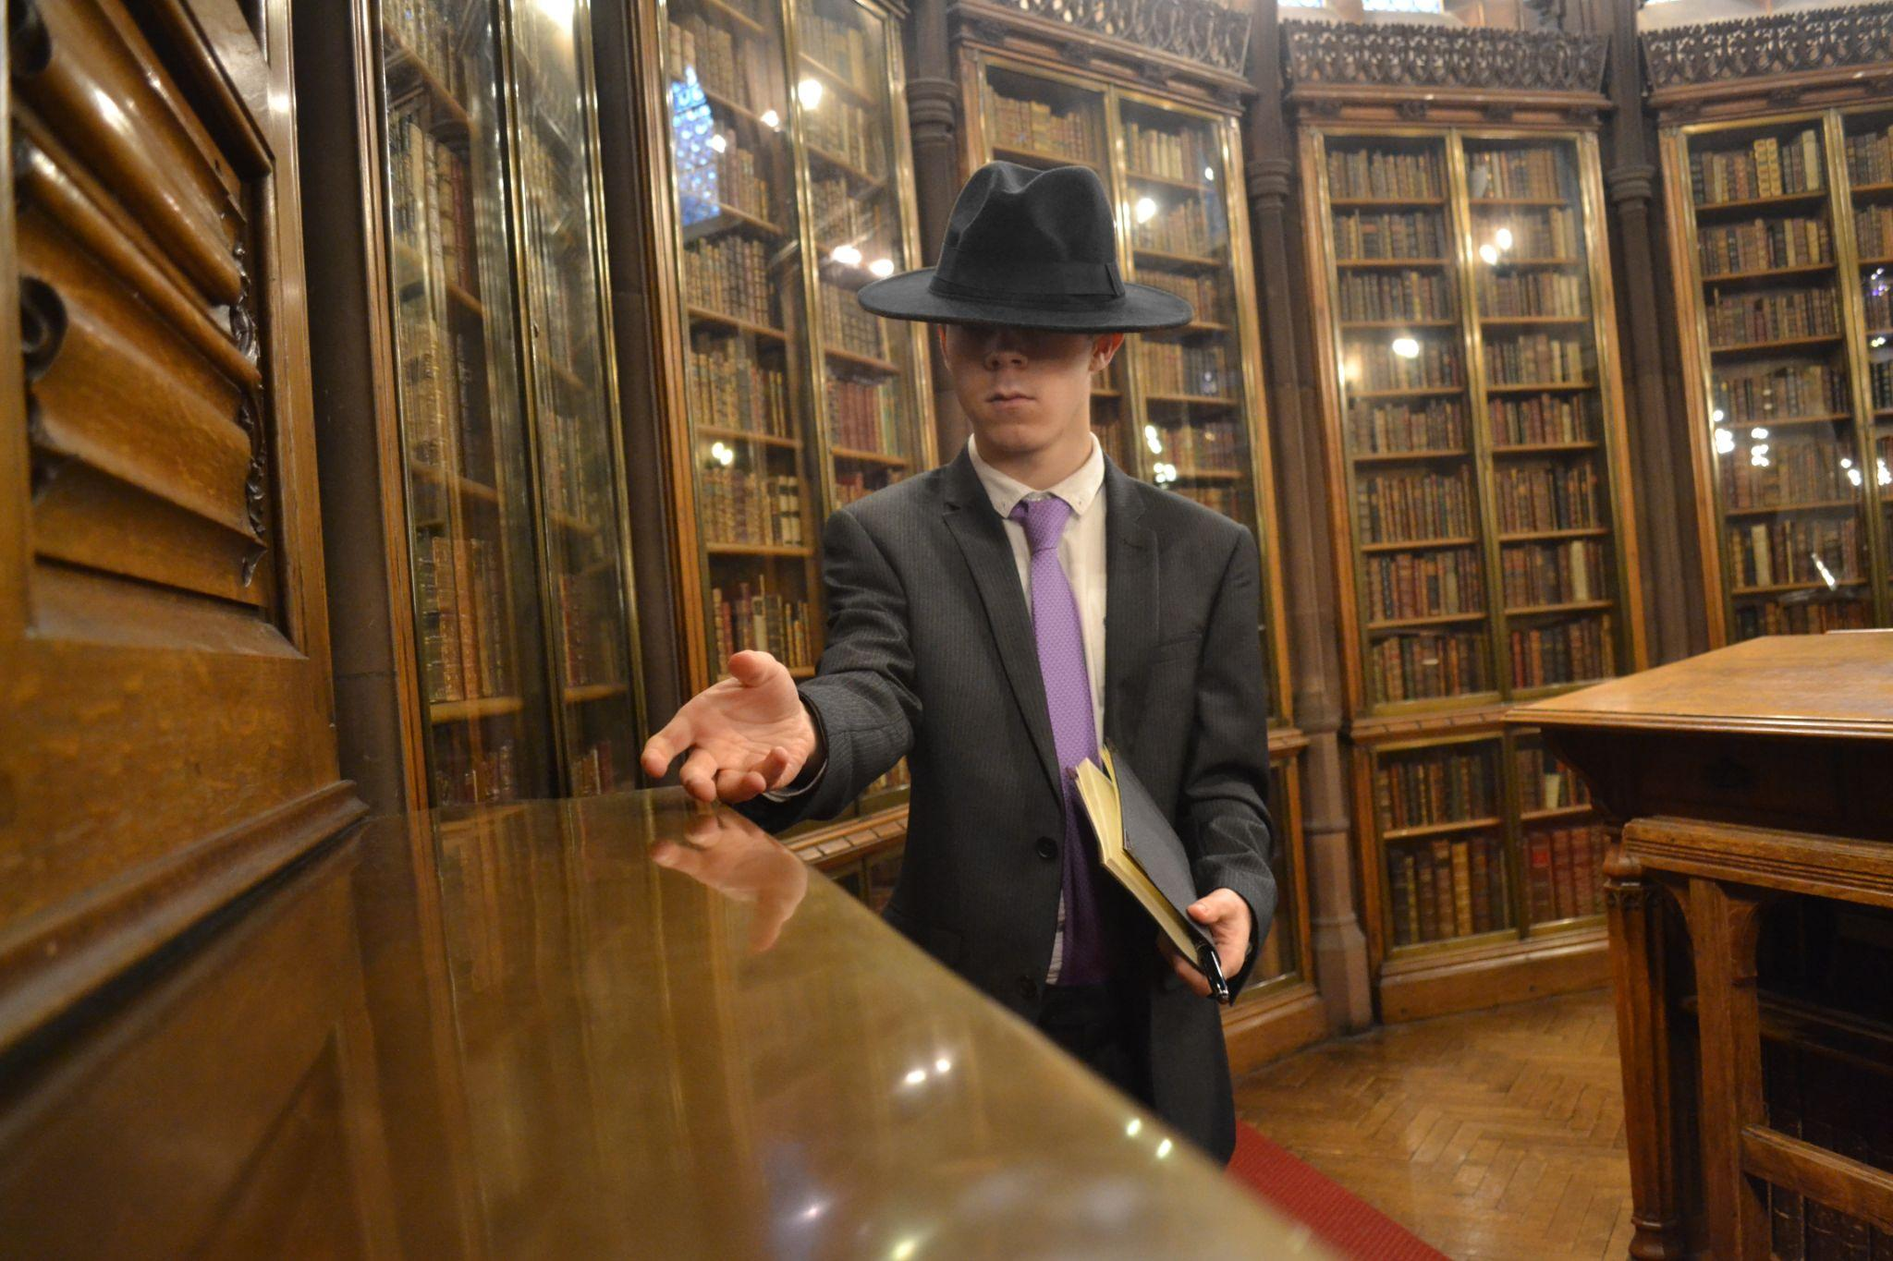
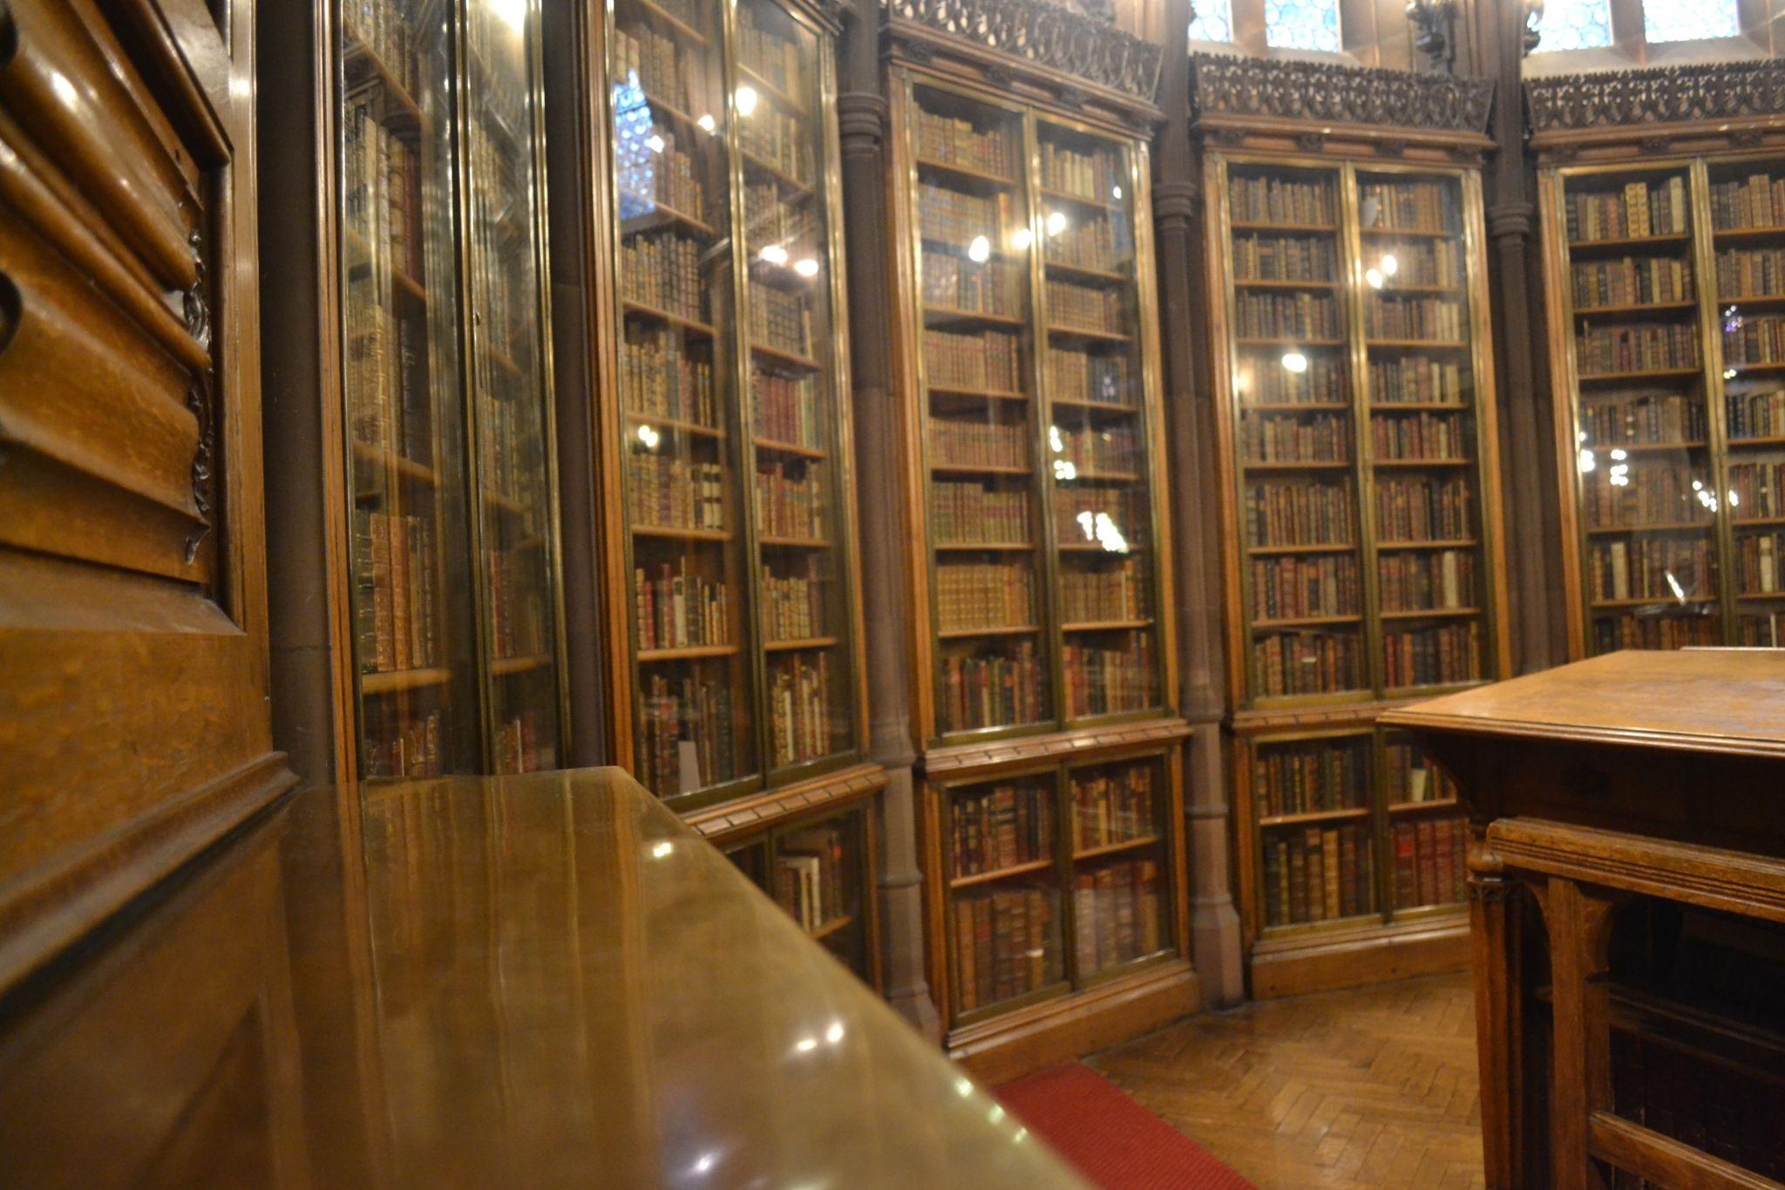
Name:
Candidate No:
Production Title:
Sheet 7 of 22
Scene Heading | INT. STUDY – Day:
Shot No. | 5
Shot Type/ camera movement
Lighting
Action/scene description/ dialogue from the screenplay | He picks up a BLACK PEN, the pocket watch, and a BOUQUET OF ROSES.
Diegetic Sound | Ambient sound of the location
Non Diegetic sound
Duration of shot |  | Transition Type

Slide 8
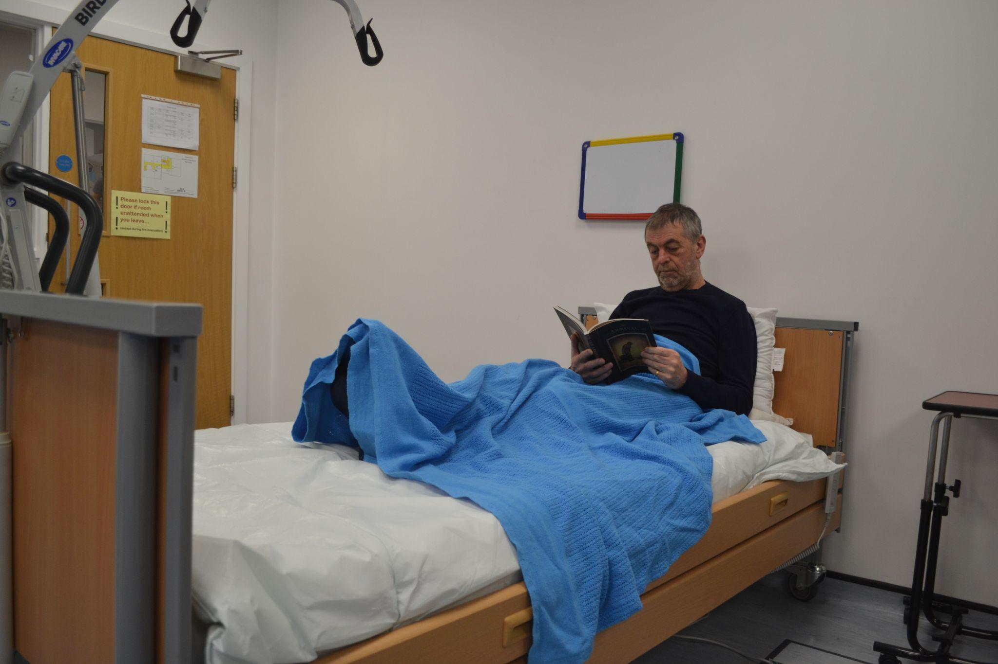
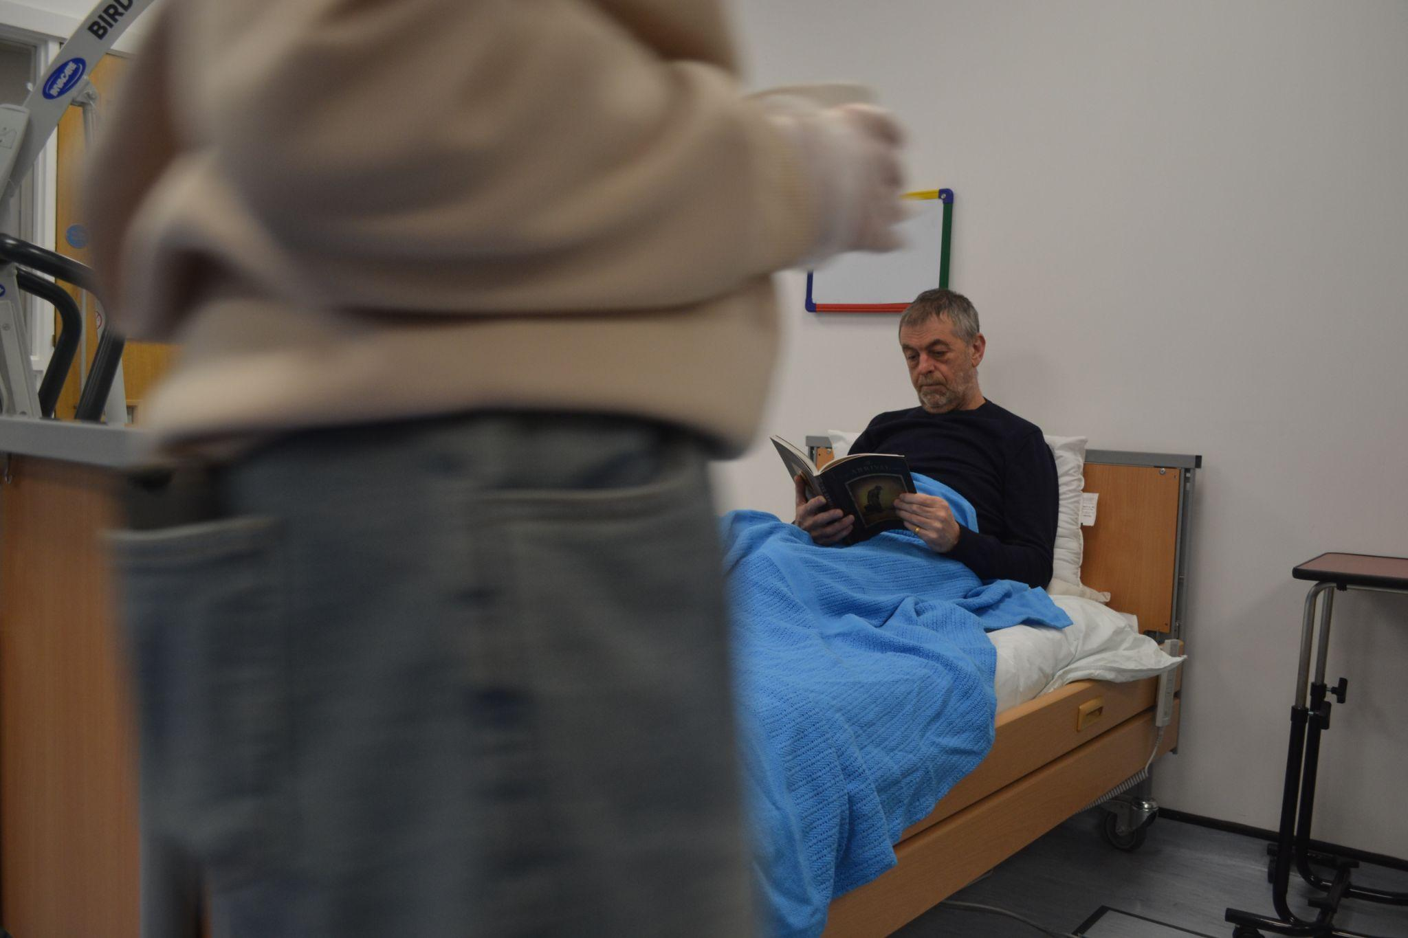
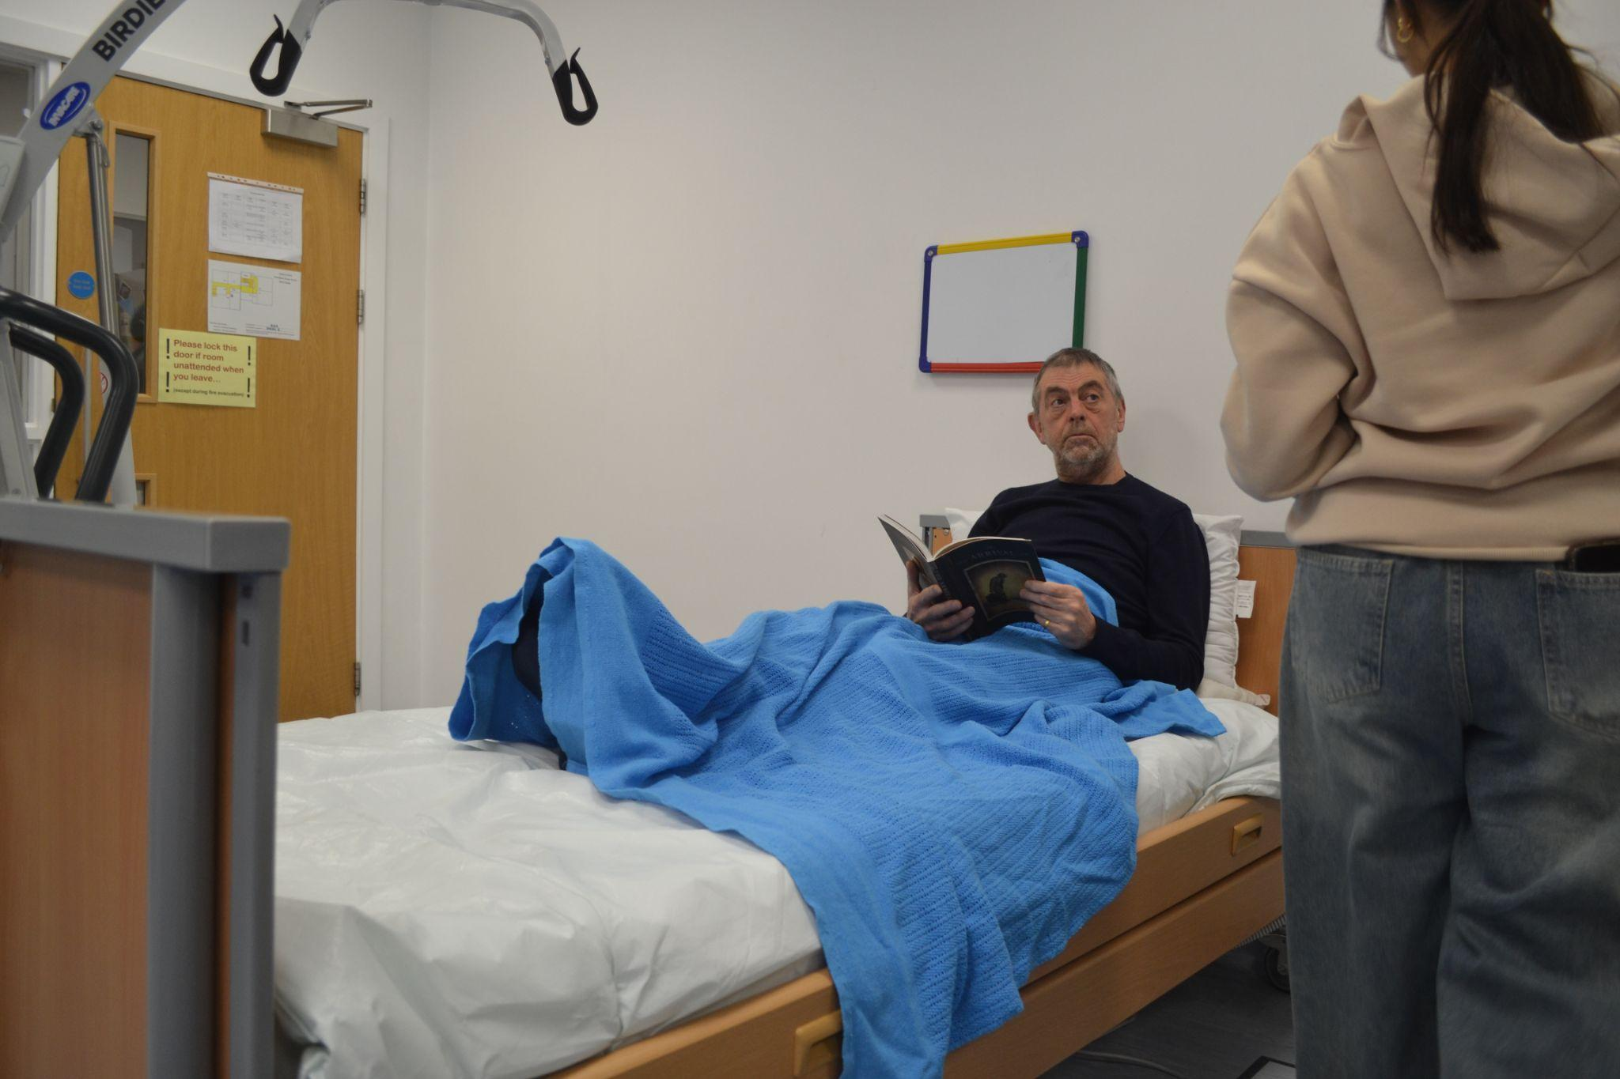
Name:
Candidate No:
Production Title:
Sheet 8 of 22
Scene Heading
Shot No. | 6
Shot Type/ camera movement
Lighting
Action/scene description/ dialogue from the screenplay | A nurse comes round to hand the man in the hospital bed a cup of tea
Diegetic Sound | Ambient sound of the location
Non Diegetic sound
Duration of shot |  | Transition Type

Slide 9
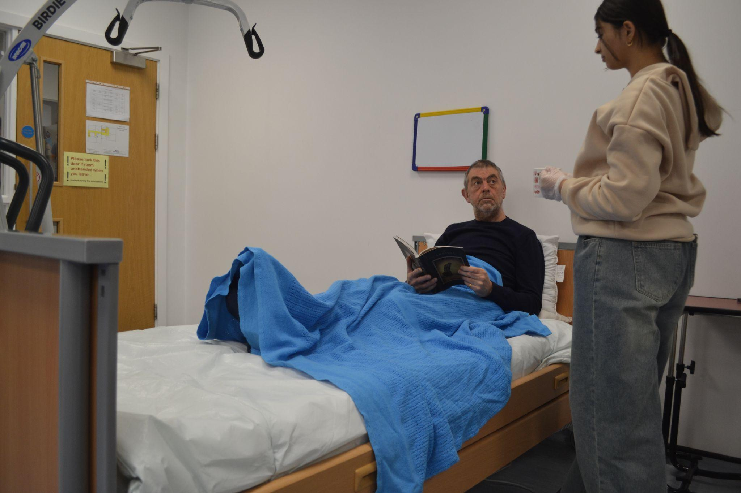
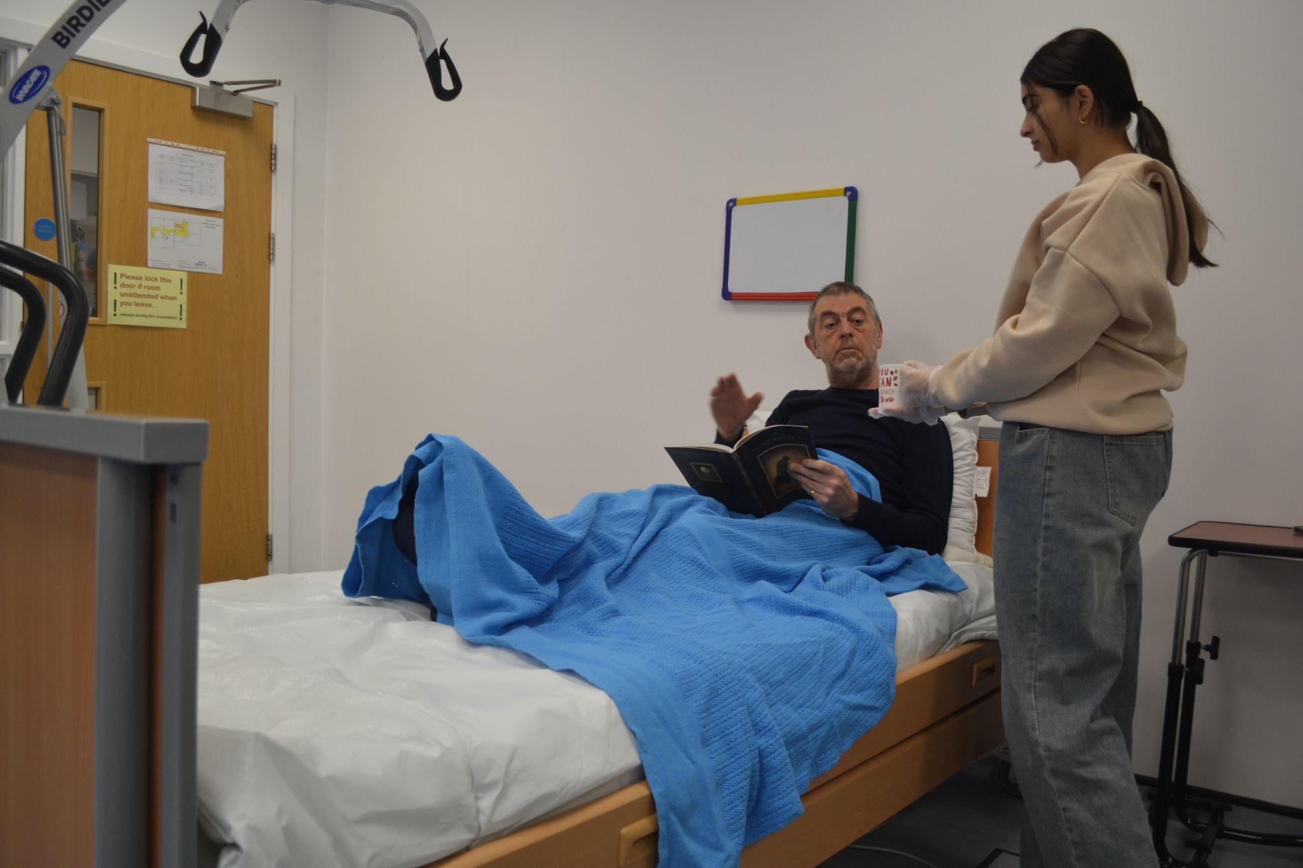
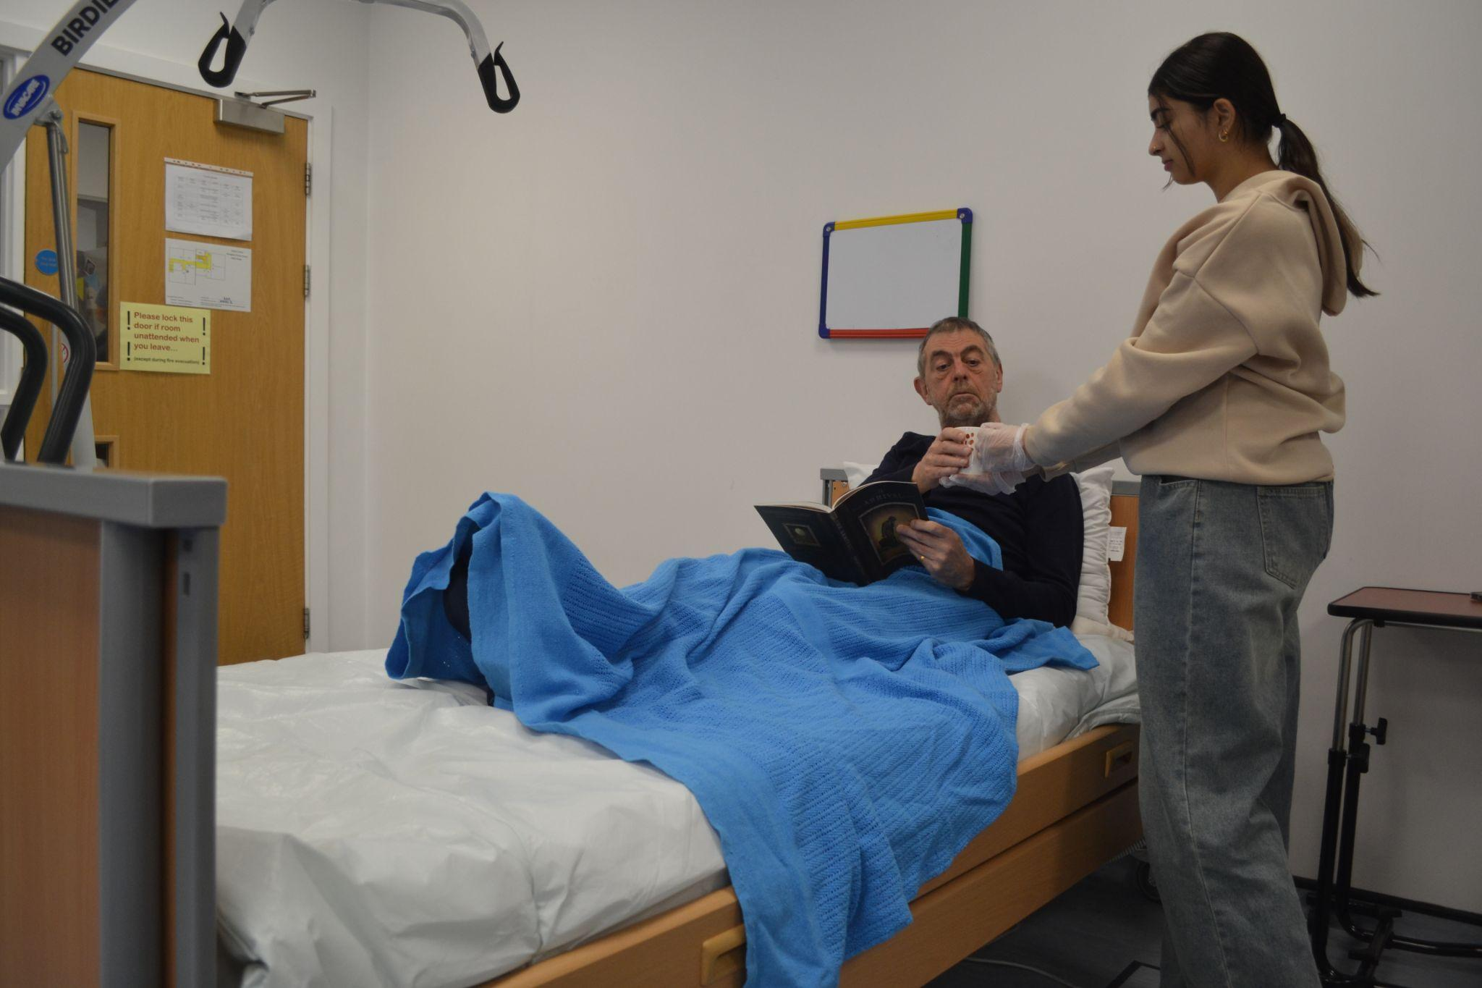
Name:
Candidate No:
Production Title:
Sheet 9 of 22
Scene Heading
Shot No. | 6
Shot Type/ camera movement
Lighting
Action/scene description/ dialogue from the screenplay | A nurse comes round to hand the man in the hospital bed a cup of tea
Diegetic Sound | Ambient sound of the location
Non Diegetic sound
Duration of shot |  | Transition Type

Slide 10
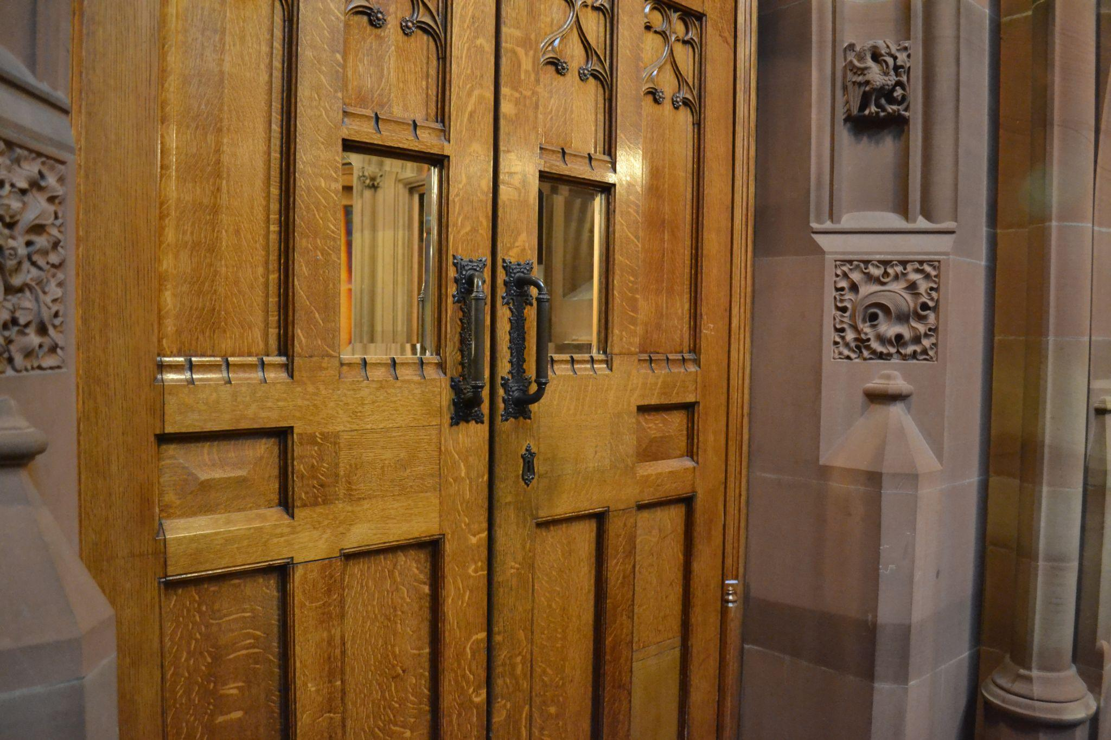
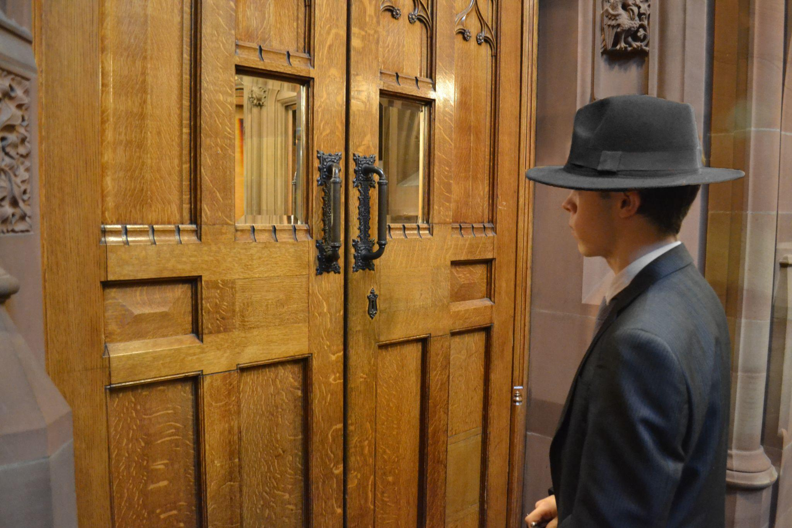
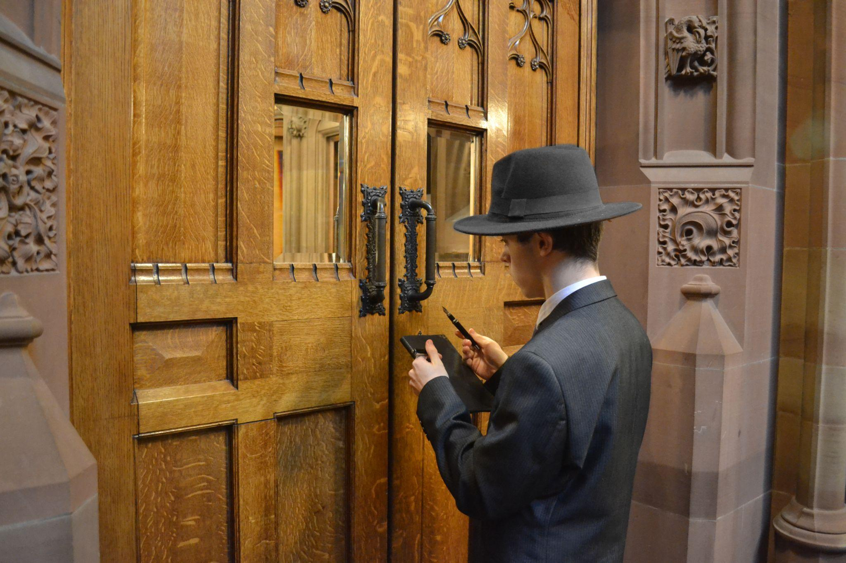
Name:
Candidate No:
Production Title:
Sheet 10 of 22
Scene Heading
Shot No. | 7
Shot Type/ camera movement
Lighting
Action/scene description/ dialogue from the screenplay
Diegetic Sound | Ambient sound of the location
Non Diegetic sound
Duration of shot |  | Transition Type

Slide 11
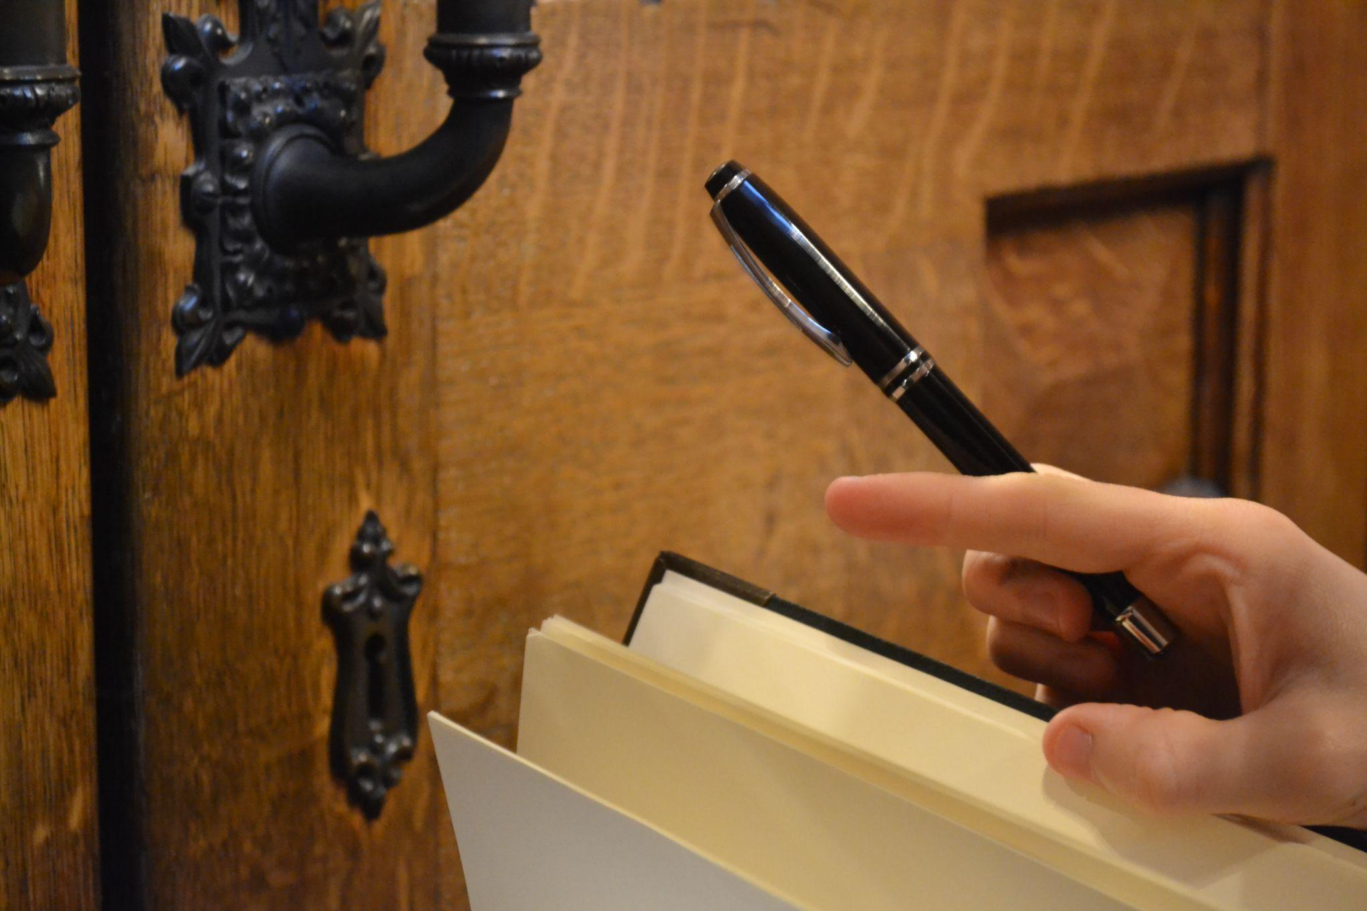
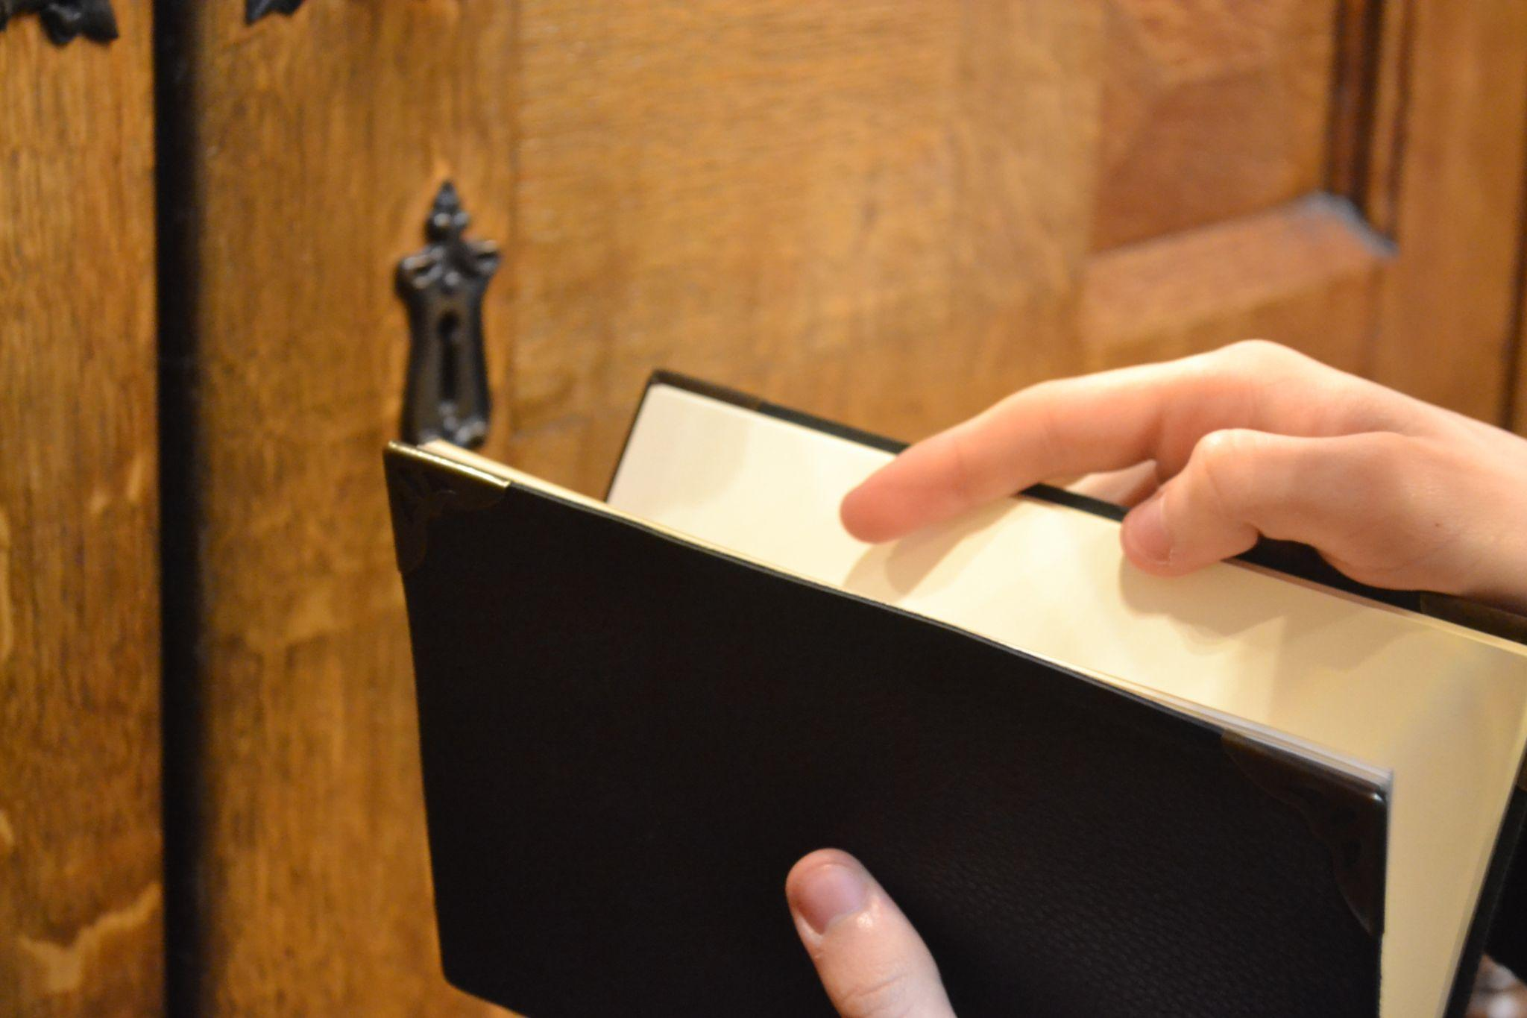
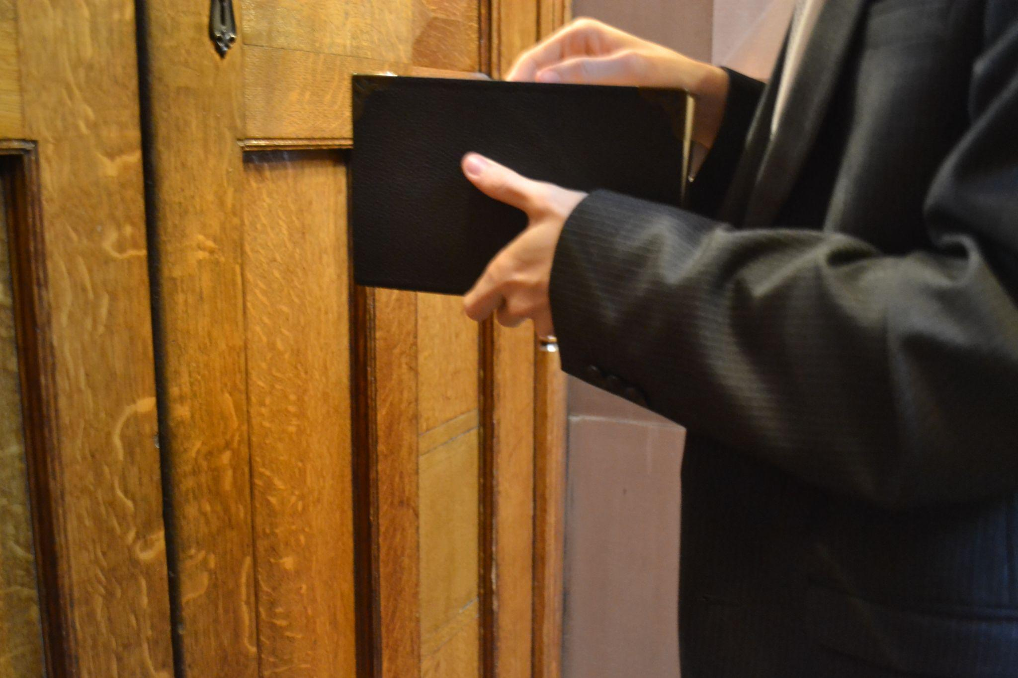
Name:
Candidate No:
Production Title:
Sheet 11 of 22
Scene Heading
Shot No. | 8
Shot Type/ camera movement
Lighting
Action/scene description/ dialogue from the screenplay
Diegetic Sound | Ambient sound of the location
Non Diegetic sound
Duration of shot |  | Transition Type

Slide 12
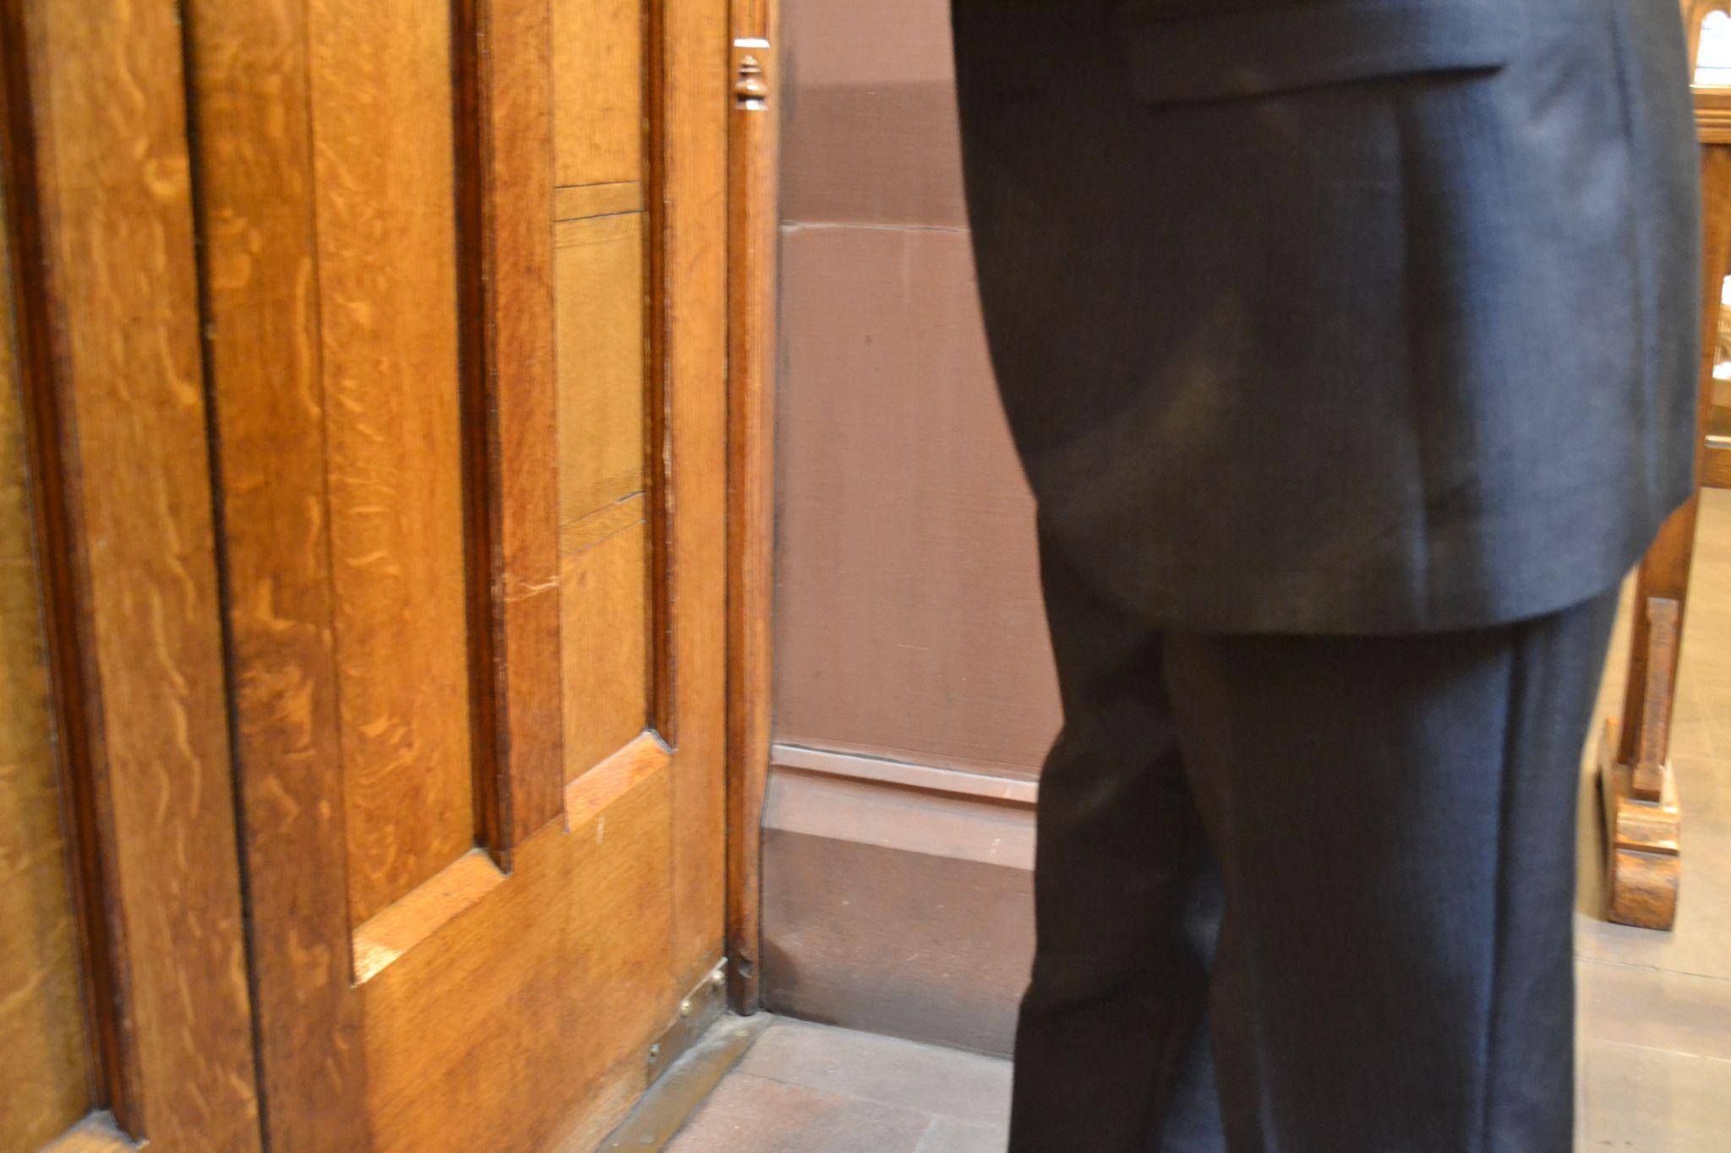
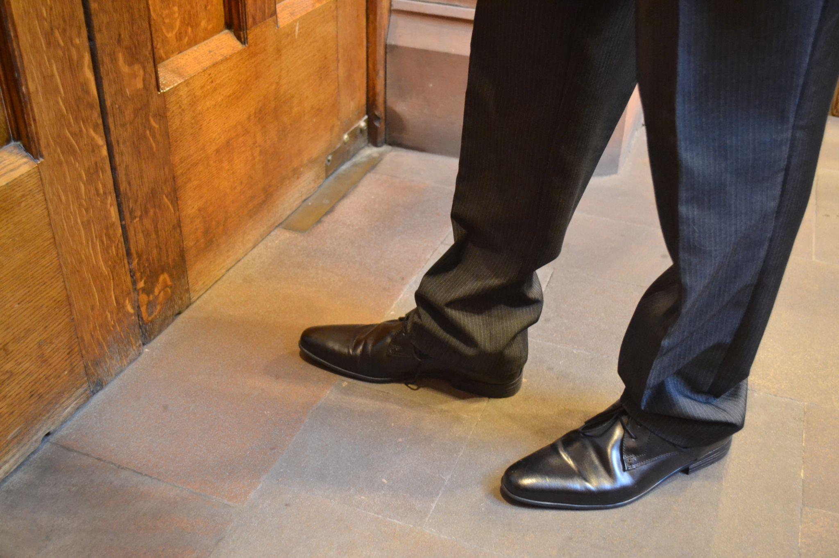
Name:
Candidate No:
Production Title:
Sheet 12 of 22
Scene Heading
Shot No. | 8
Shot Type/ camera movement
Lighting
Action/scene description/ dialogue from the screenplay
Diegetic Sound | Ambient sound of the location
Non Diegetic sound
Duration of shot |  | Transition Type

Slide 13
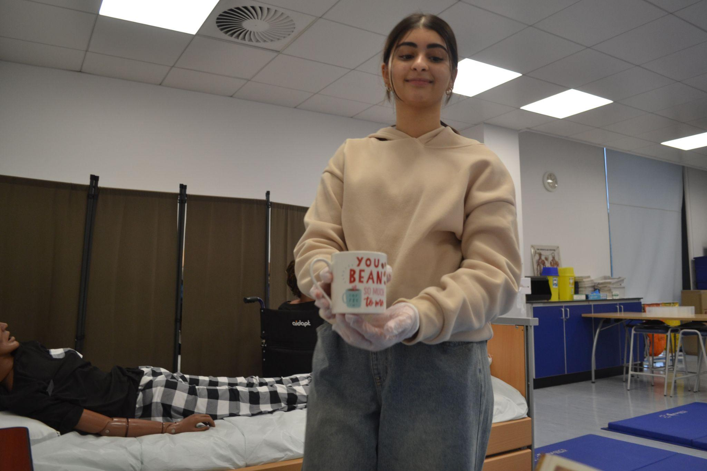
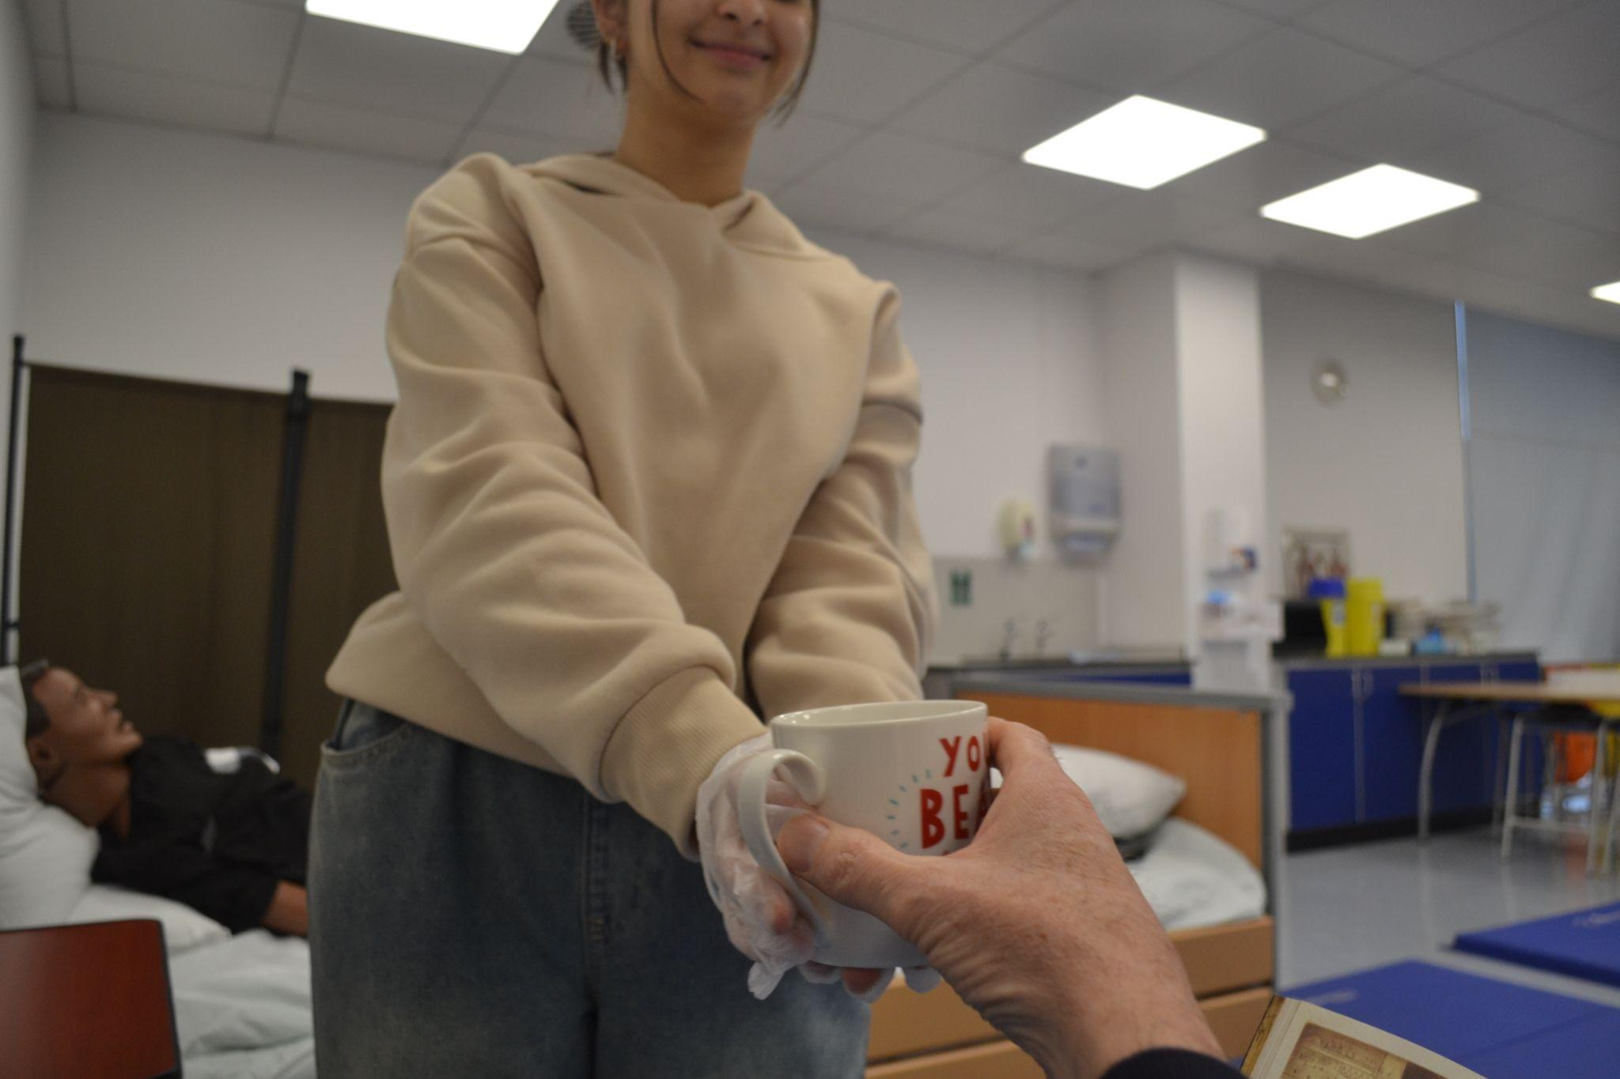
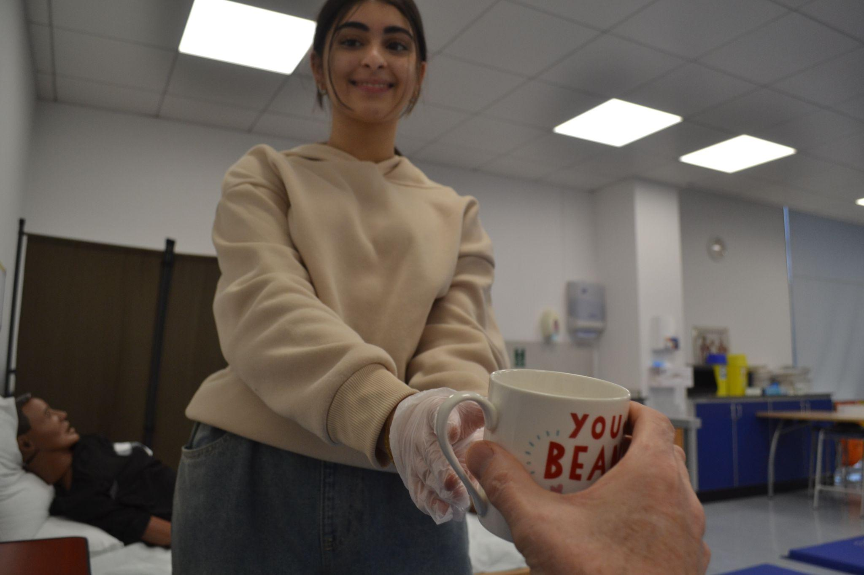
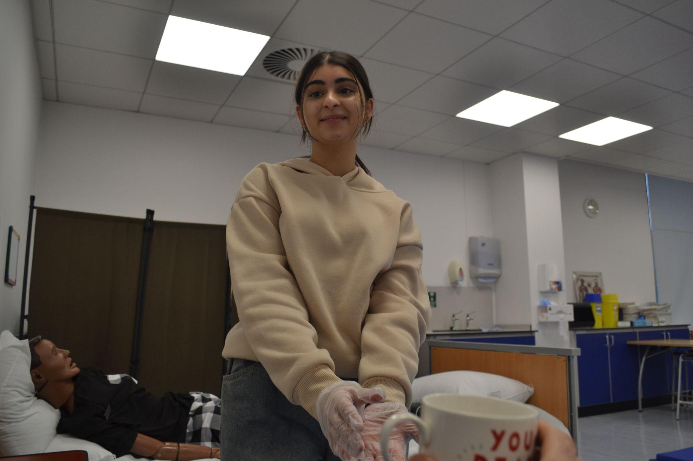
Name:
Candidate No:
Production Title:
Sheet 13 of 22
Scene Heading
Shot No. | 9
Shot Type/ camera movement
Lighting
Action/scene description/ dialogue from the screenplay
Diegetic Sound | Ambient sound of the location
Non Diegetic sound
Duration of shot |  | Transition Type

Slide 14
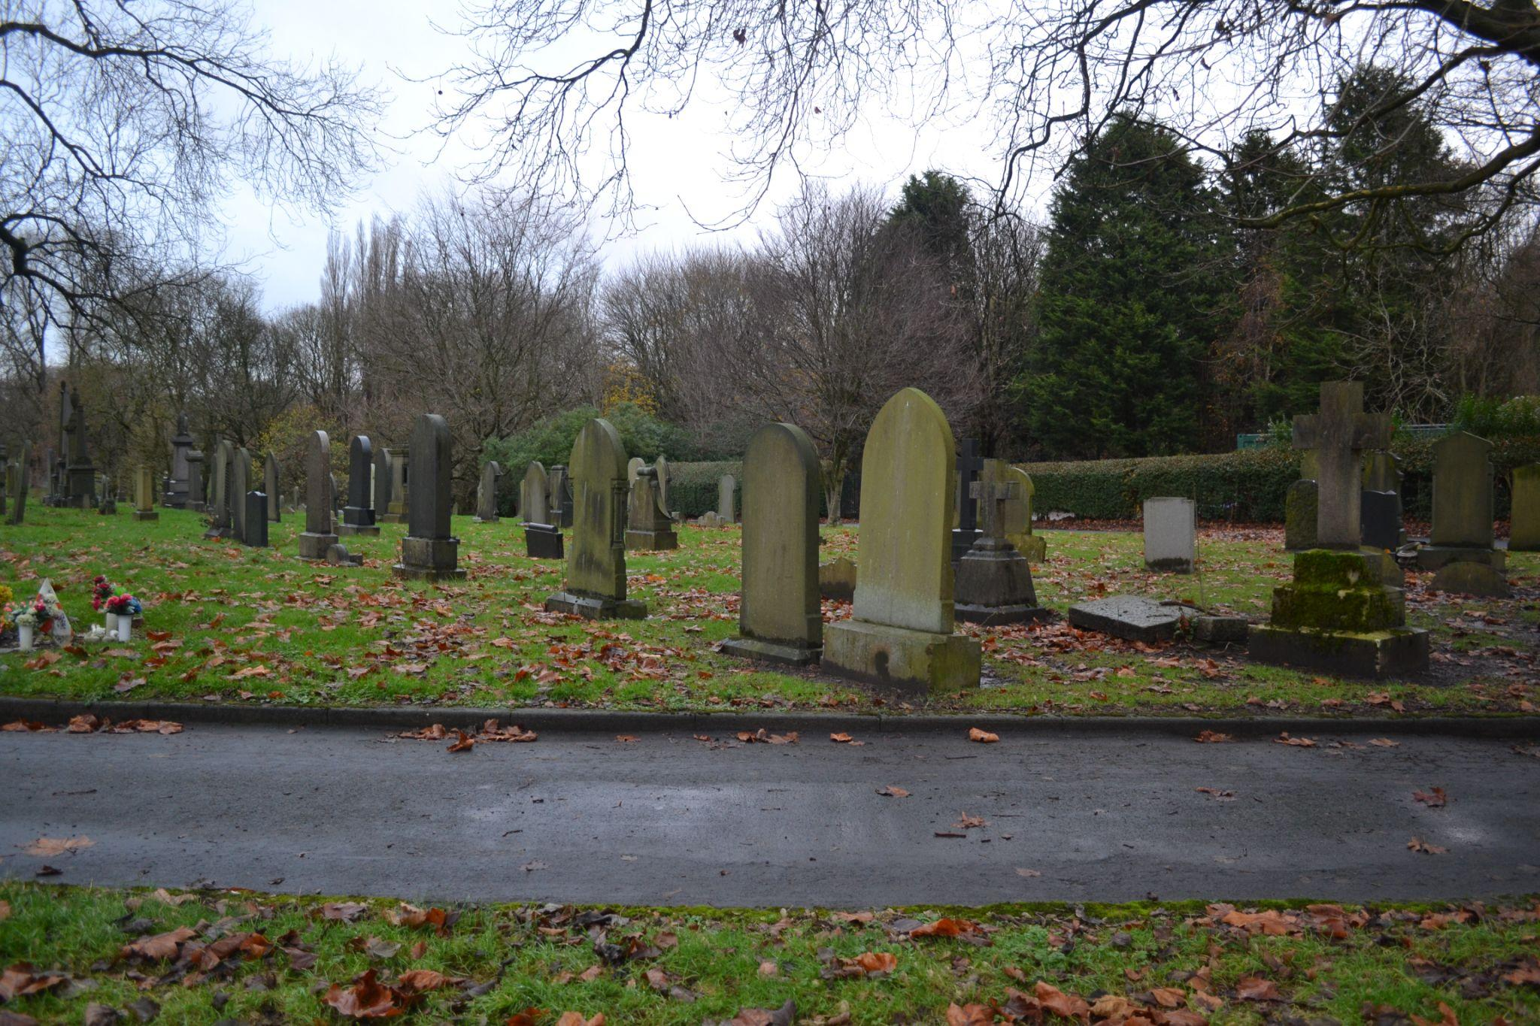
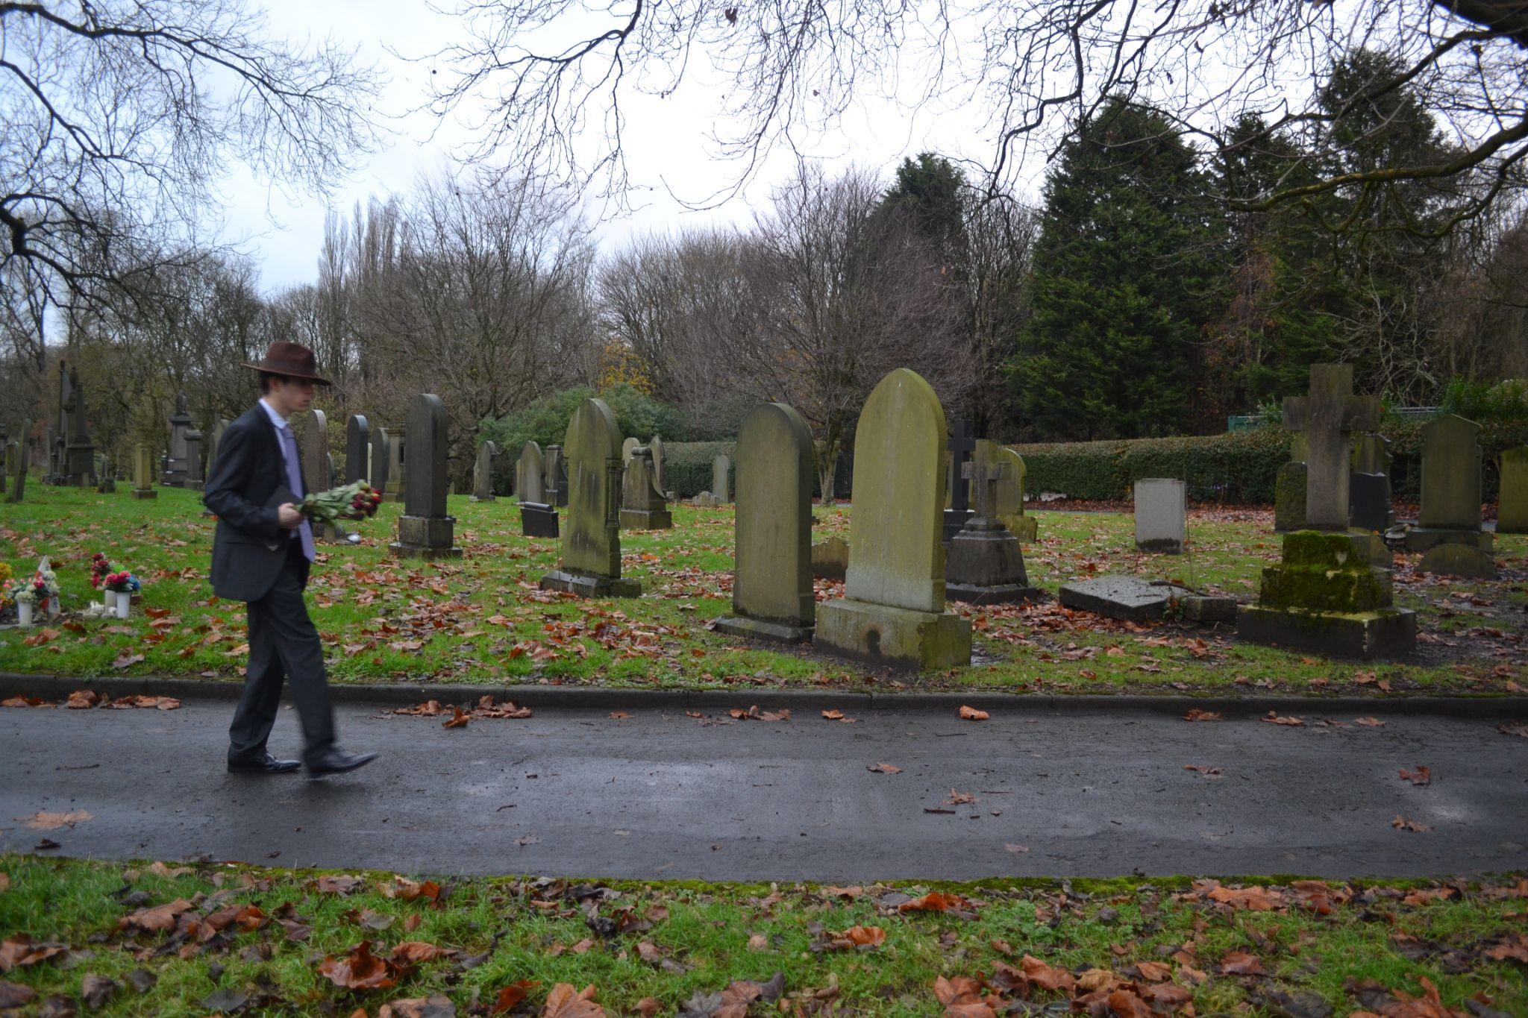
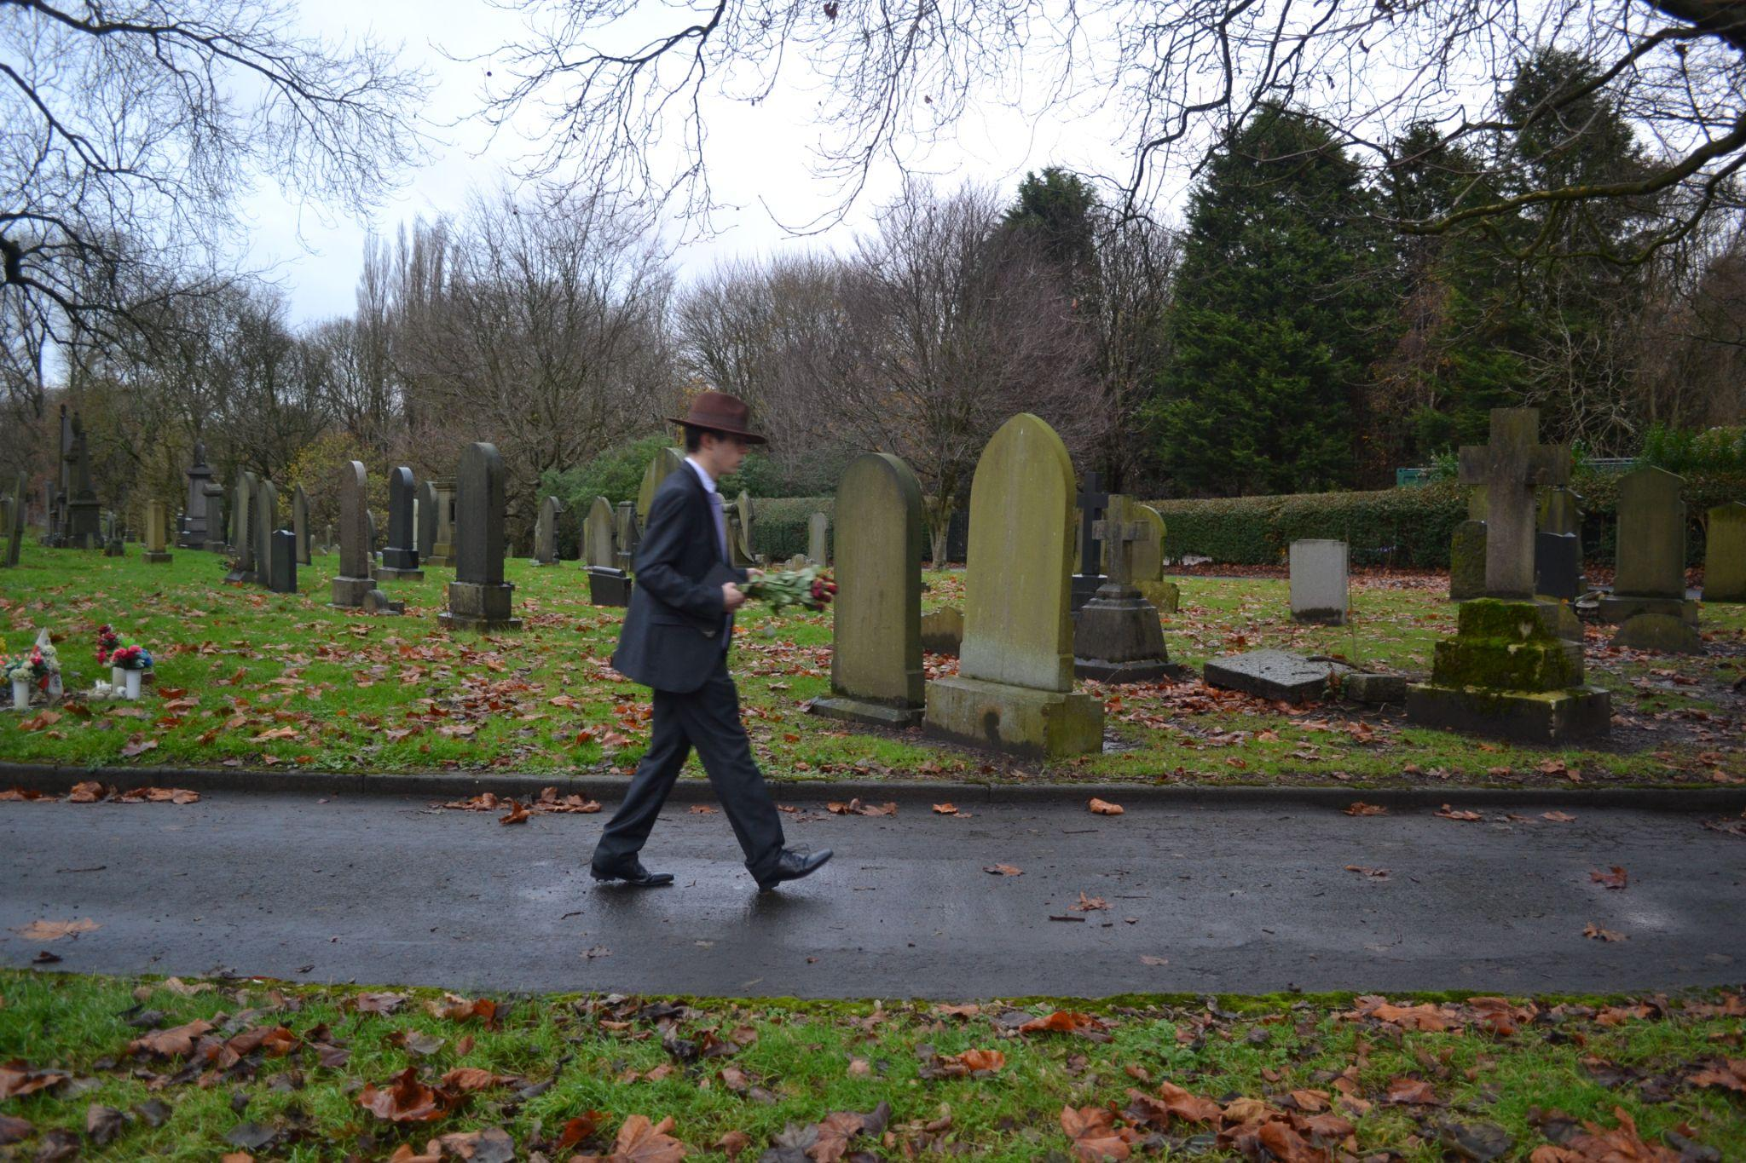
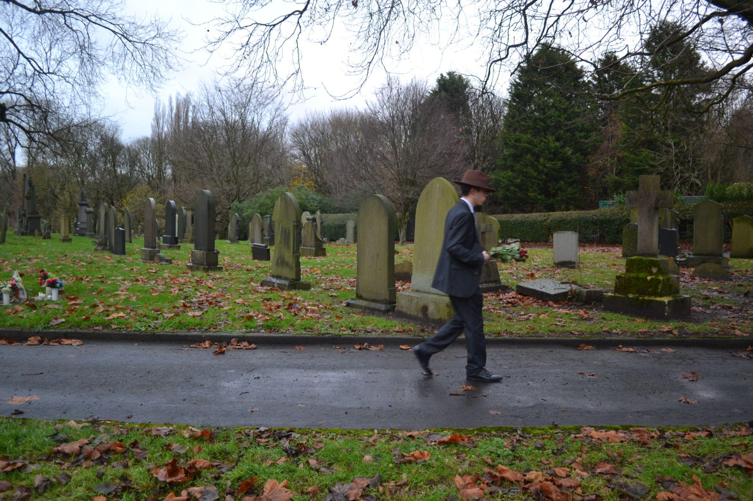
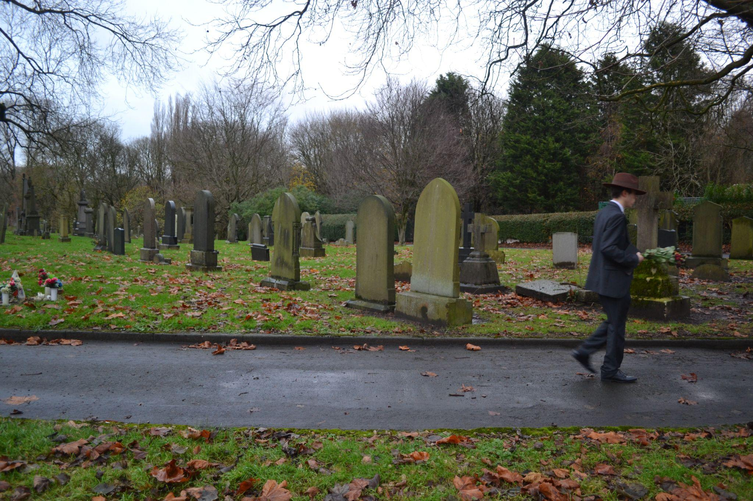
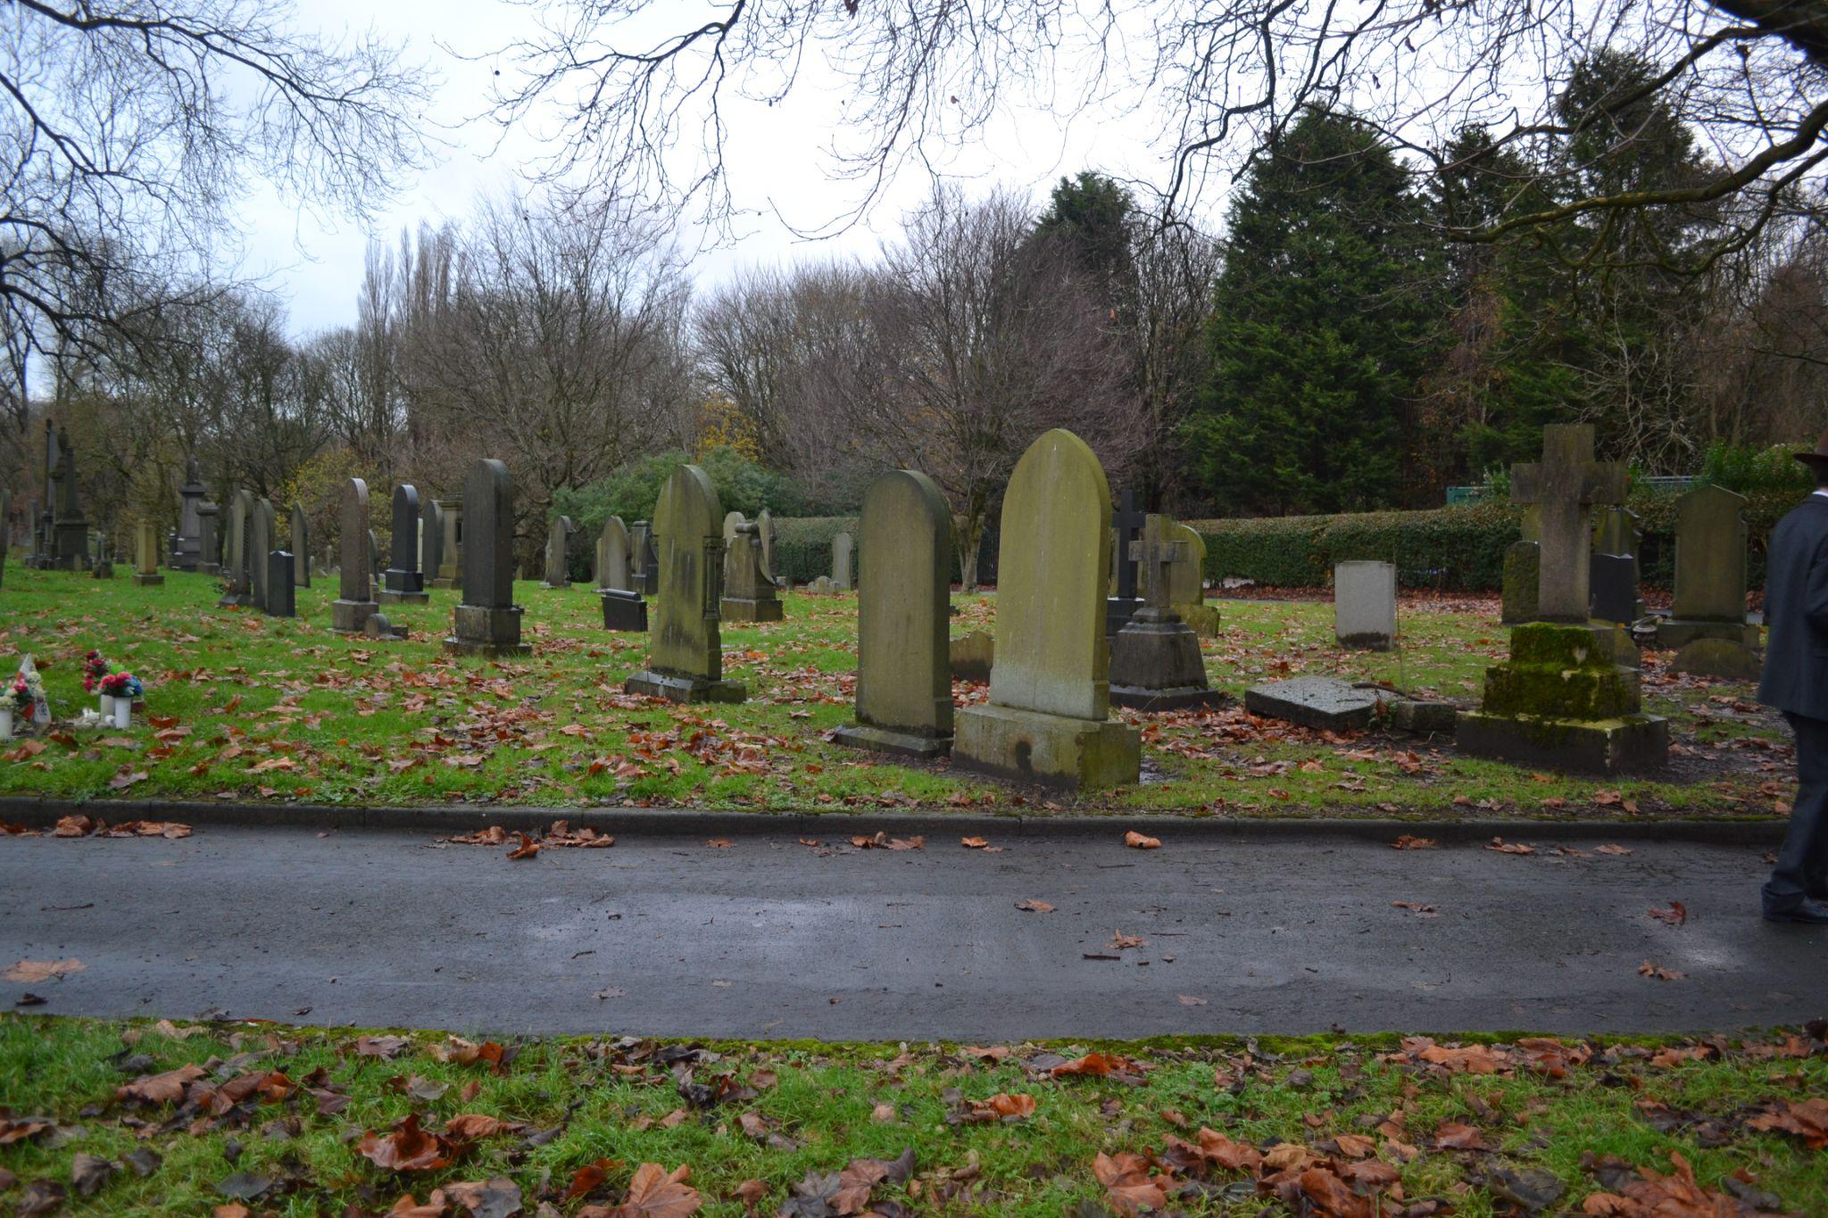
Sheet 14 of 22
Scene Heading
Shot No. | 10
Shot Type/ camera movement
Lighting
Action/scene description/ dialogue from the screenplay | The Mysterious Man walks through a foggy cemetery, the path is silent, only the footsteps and rustles of leaves can be heard.
Diegetic Sound | Ambient sound of the location
Non Diegetic sound
Duration of shot |  | Transition Type

Slide 15
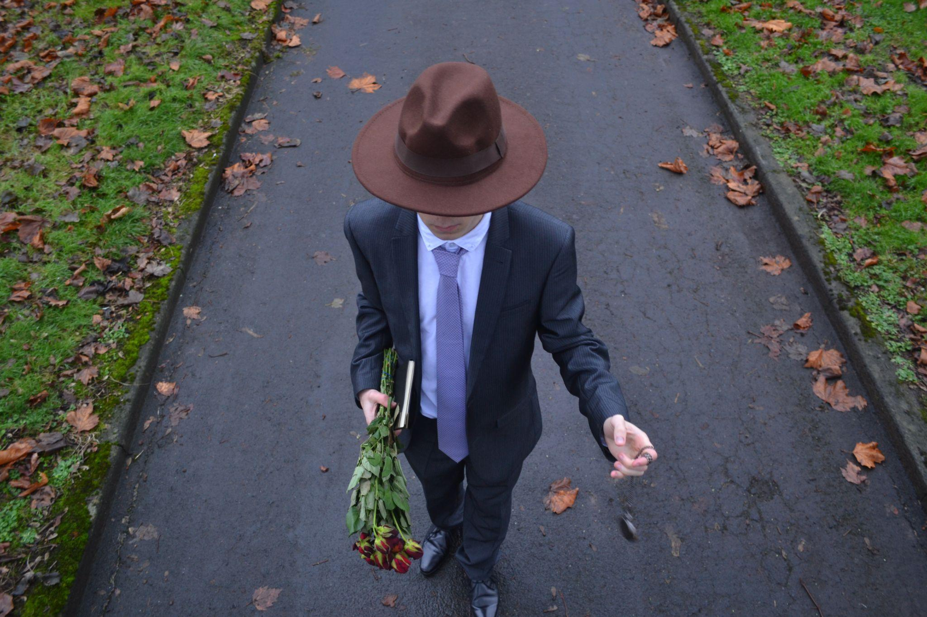
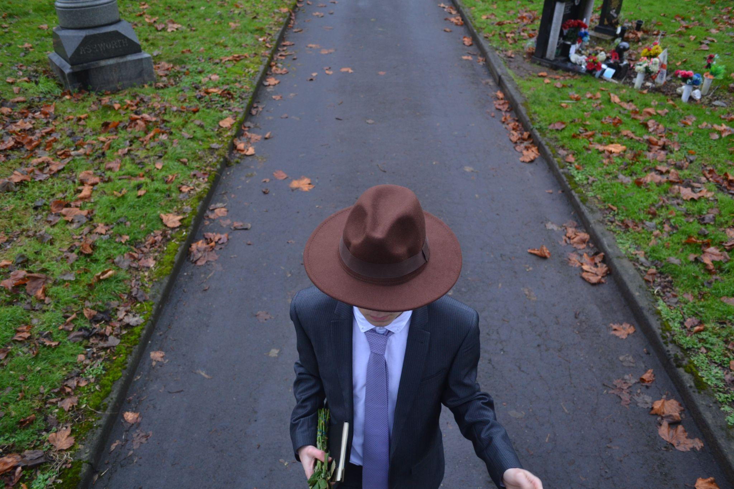
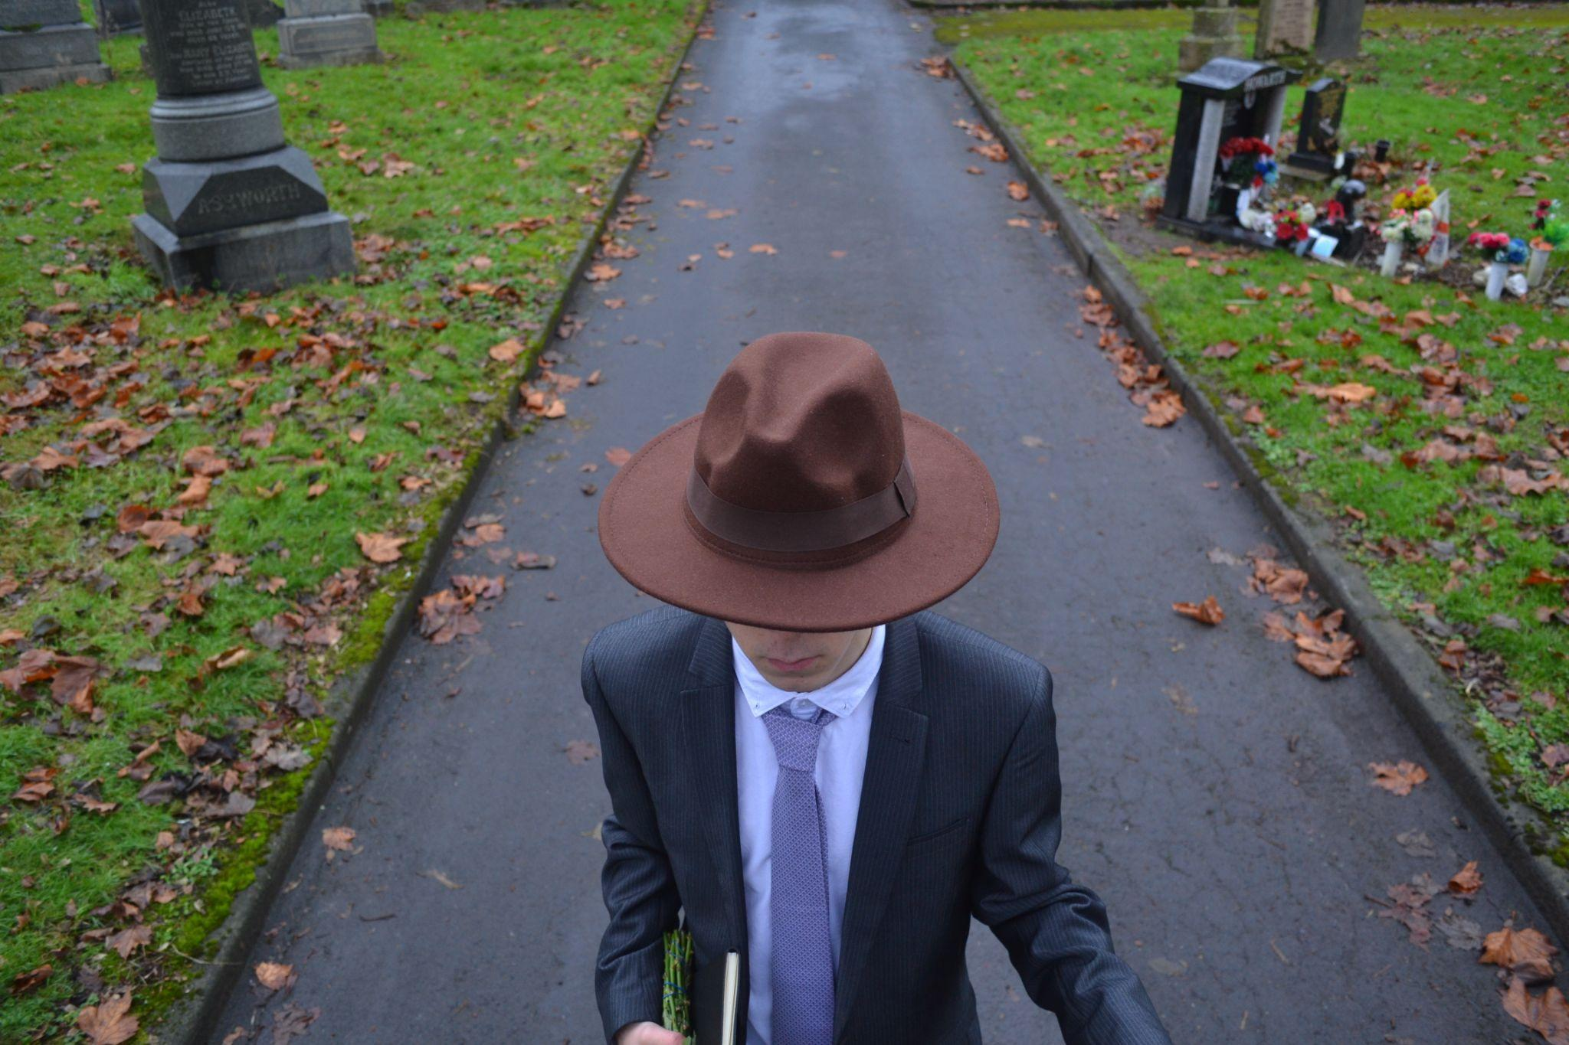
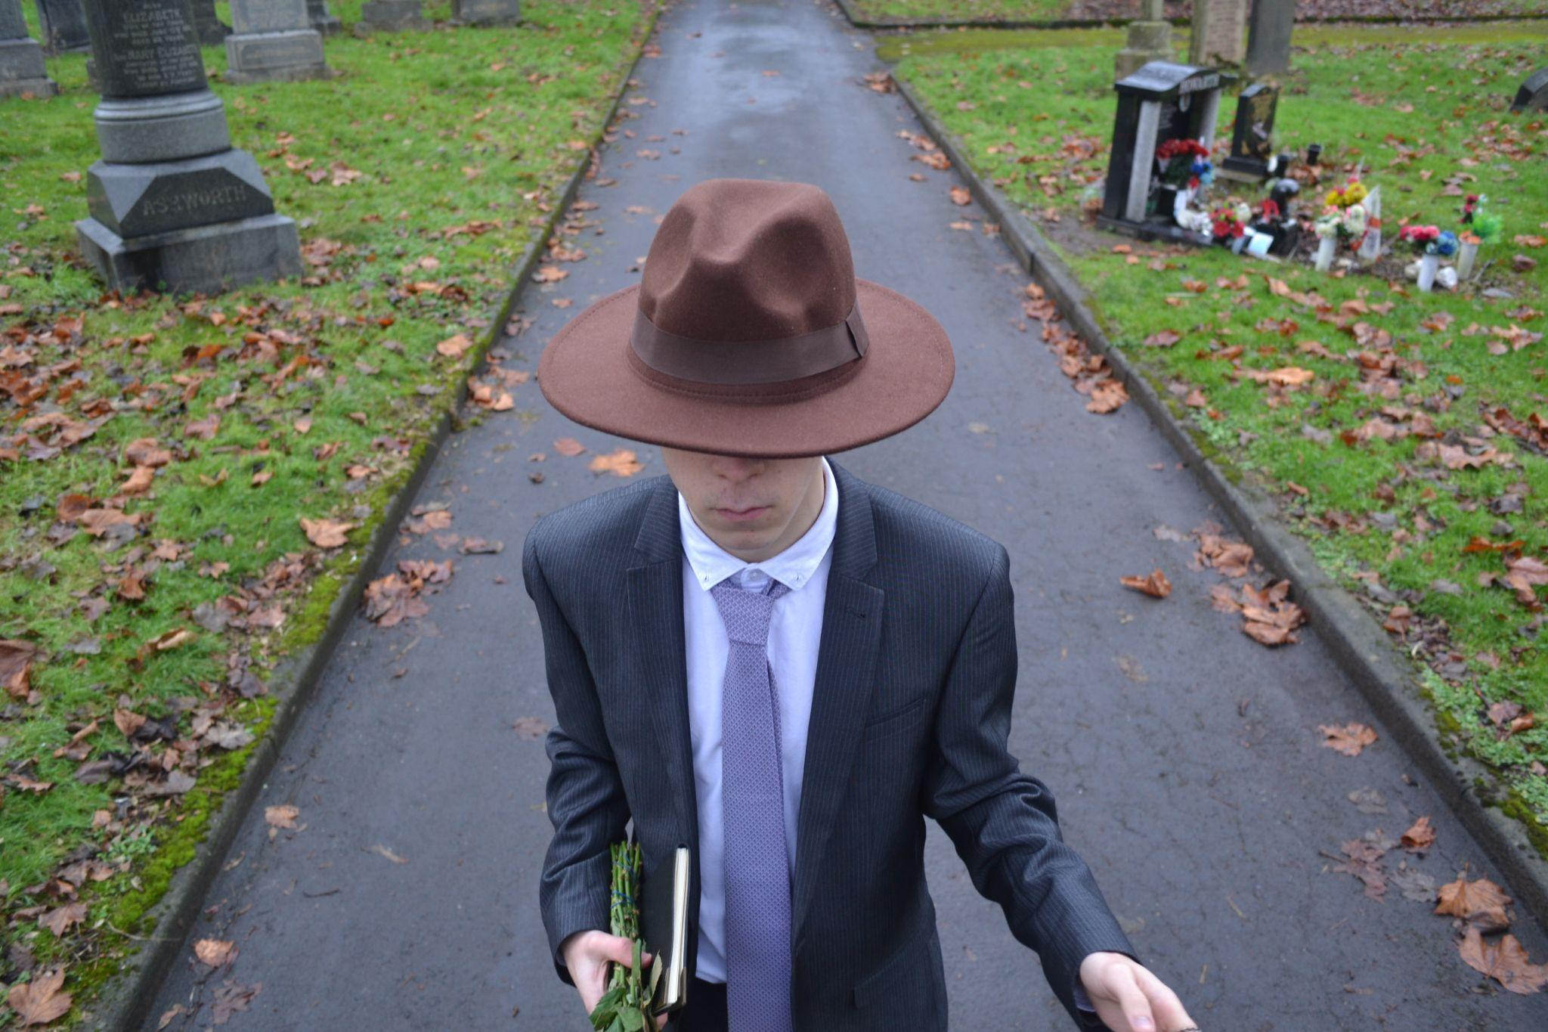
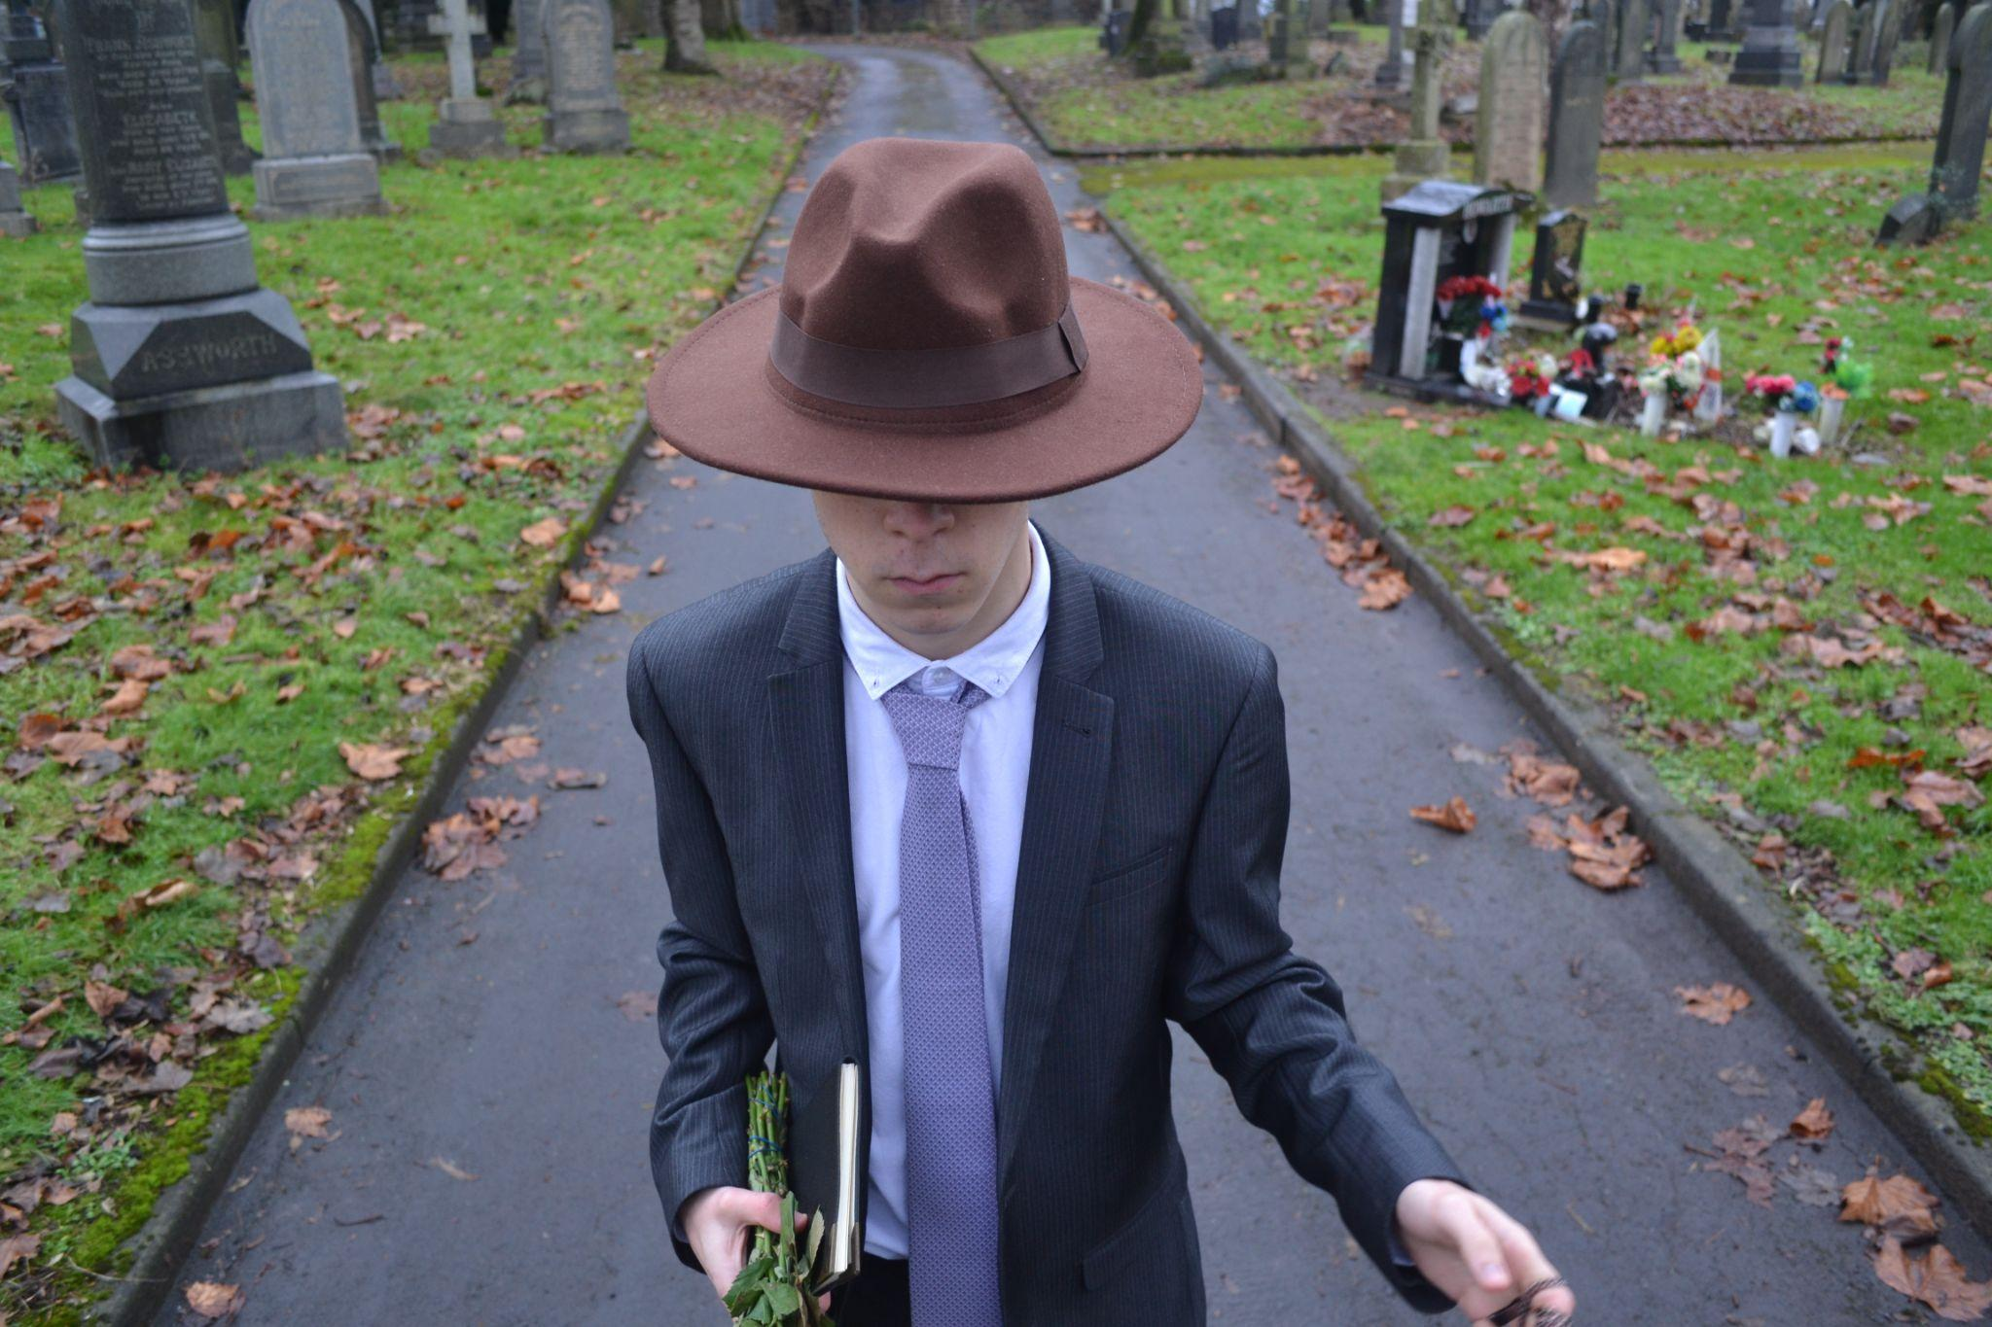
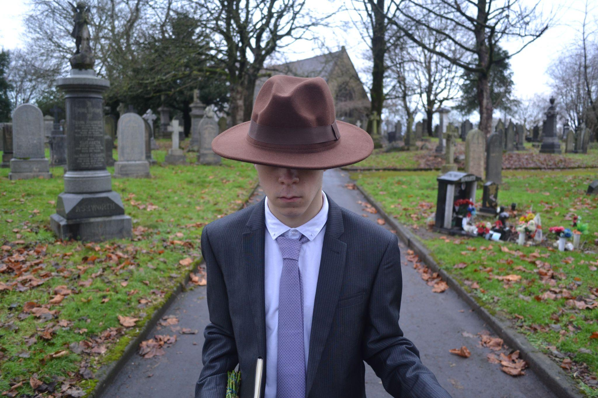
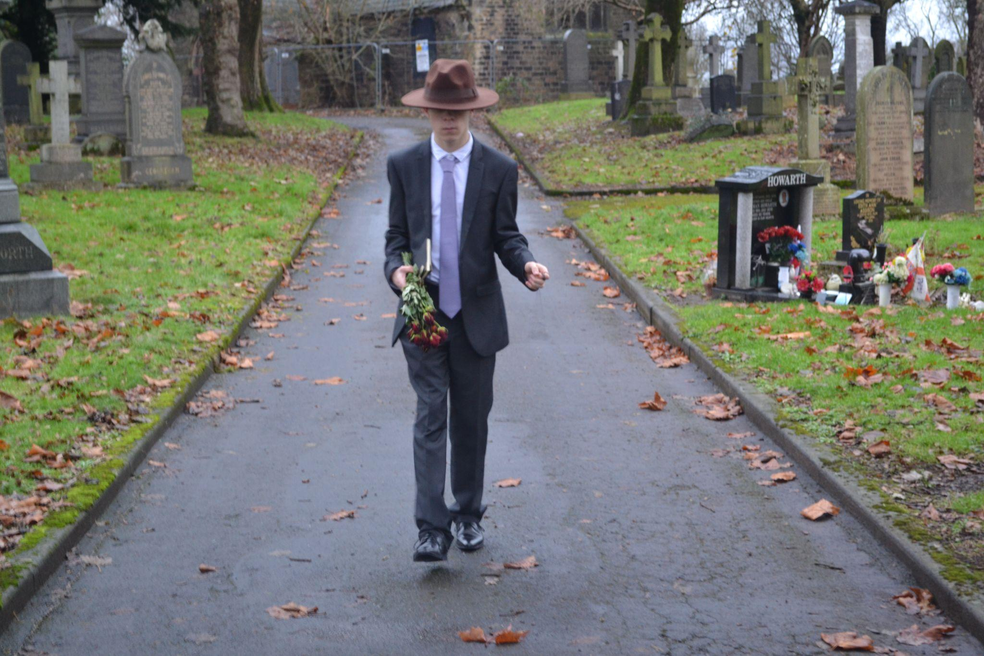
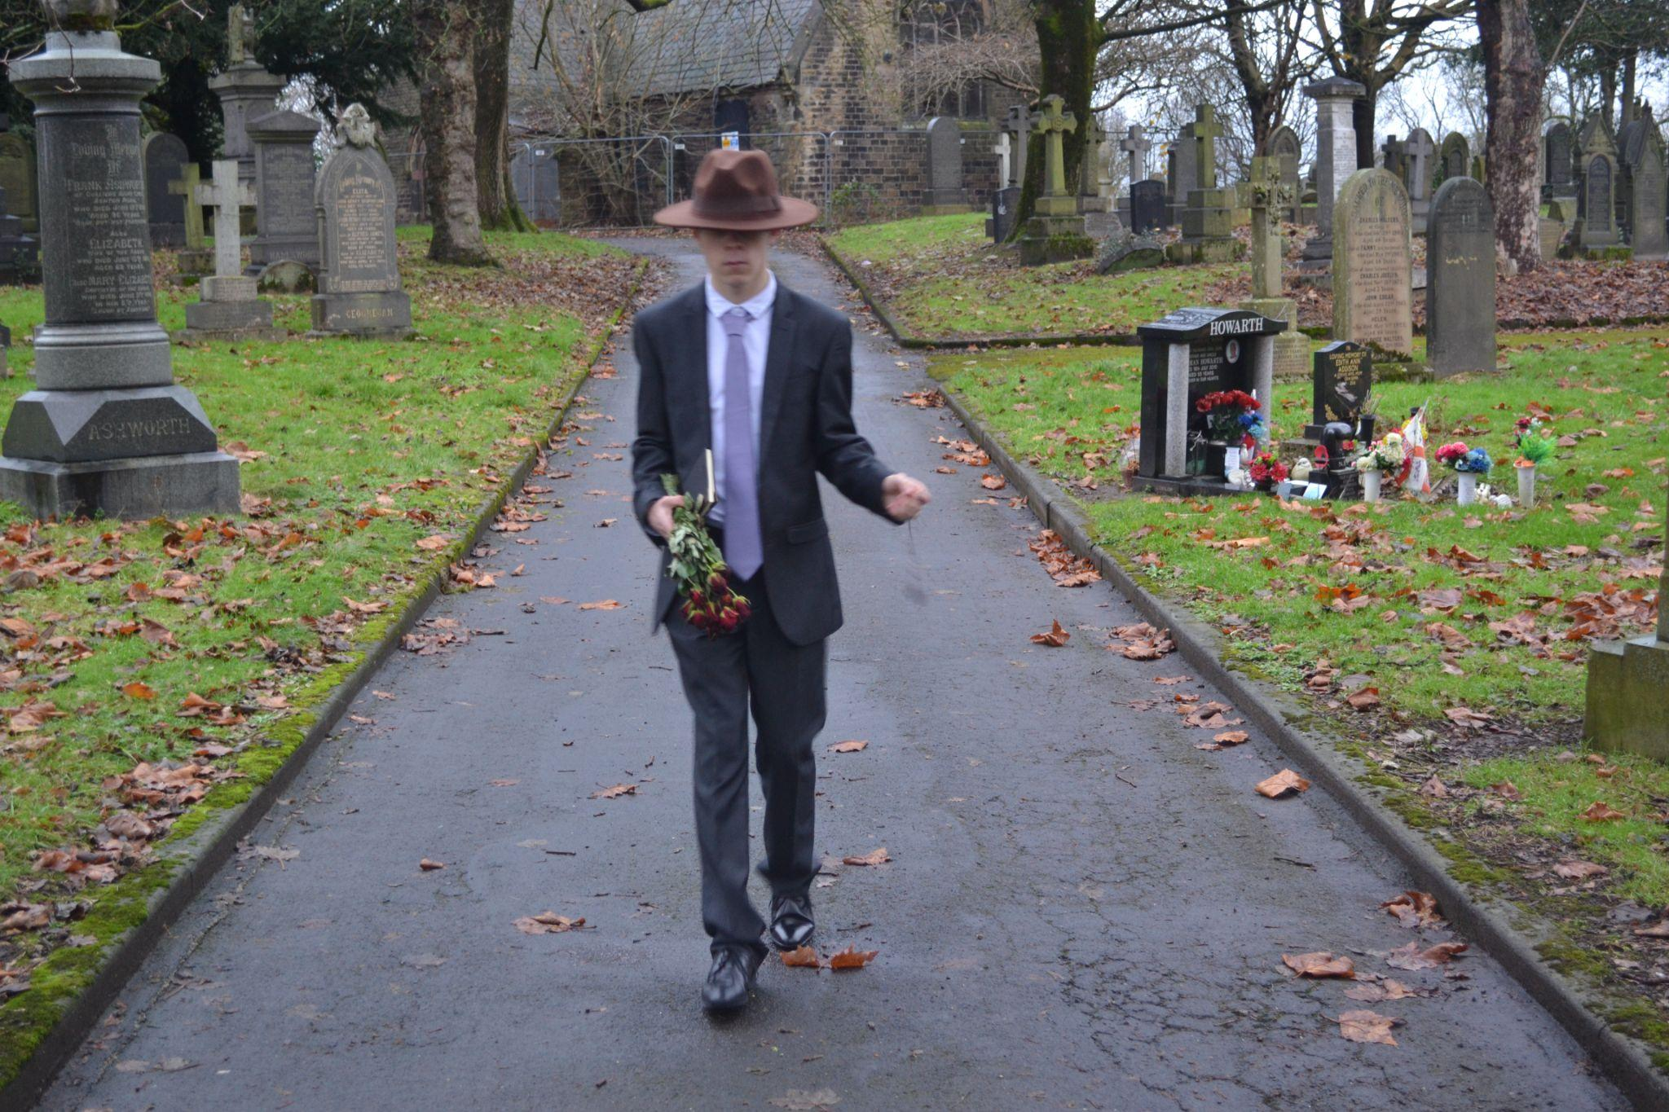
Sheet 15 of 22
Scene Heading
Shot No. | 11 + 12
Shot Type/ camera movement
Lighting
Action/scene description/ dialogue from the screenplay | The Mysterious Man walks through a foggy cemetery, the path is silent, only the footsteps and rustles of leaves can be heard.
Diegetic Sound | Ambient sound of the location
Non Diegetic sound
Duration of shot |  | Transition Type

Slide 16



Sheet 16 of 22
Scene Heading
Shot No. | 13
Shot Type/ camera movement
Lighting
Action/scene description/ dialogue from the screenplay | A mother and her child walk past either side of the mysterious man, ignoring his presents as though he is a ghost.
Diegetic Sound | Ambient sound of the location
Non Diegetic sound
Duration of shot |  | Transition Type

Slide 17


Name:
Candidate No:
Production Title:
Sheet 17 of 10
Scene Heading
Shot No. | 13
Shot Type/ camera movement
Lighting
Action/scene description/ dialogue from the screenplay | A mother and her child walk past either side of the mysterious man, ignoring his presents as though he is a ghost.
Diegetic Sound | Ambient sound of the location
Non Diegetic sound
Duration of shot |  | Transition Type

Slide 18



Name:
Candidate No:
Production Title:
Sheet 18 of 10
Scene Heading | INT. HOSPITAL - EARLY MORNING DAY:
Shot No. | 14
Shot Type/ camera movement
Lighting
Action/scene description/ dialogue from the screenplay | The Old hospital patient sits in his bed, drinking his cup of tea
Diegetic Sound | Ambient sound of the location
Non Diegetic sound
Duration of shot |  | Transition Type

Slide 19



Name:
Candidate No:
Production Title:
Sheet 19 of 10
Scene Heading
Shot No. | 14
Shot Type/ camera movement
Lighting
Action/scene description/ dialogue from the screenplay
Diegetic Sound | Ambient sound of the location
Non Diegetic sound
Duration of shot |  | Transition Type

Slide 20
Name:
Candidate No:
Production Title:
Sheet 20 of 10
Scene Heading
Shot No. | 15
Shot Type/ camera movement
Lighting
Action/scene description/ dialogue from the screenplay | Fade out from shot of end of bed
Diegetic Sound | Ambient sound of the location
Non Diegetic sound
Duration of shot |  | Transition Type

Slide 21
Name:
Candidate No:
Production Title:
Sheet 21 of 10
Scene Heading
Shot No. | 15
Shot Type/ camera movement
Lighting
Action/scene description/ dialogue from the screenplay | Fade in from black to hospital shot
Diegetic Sound | Ambient sound of the location
Non Diegetic sound
Duration of shot |  | Transition Type

Slide 22

Name:
Candidate No:
Production Title:
Sheet 22 of 10
Scene Heading
Shot No. | 16
Shot Type/ camera movement
Lighting
Action/scene description/ dialogue from the screenplay | The Mysterious Man turns, stops and stands outside the hospital doors, he moves towards the entrance calmly and slowly.
Diegetic Sound | Ambient sound of the location
Non Diegetic sound
Duration of shot |  | Transition Type

